Slide 1
PROGRAM WEEK IN SZEGED
26th -30th Sept 2022

Slide 2
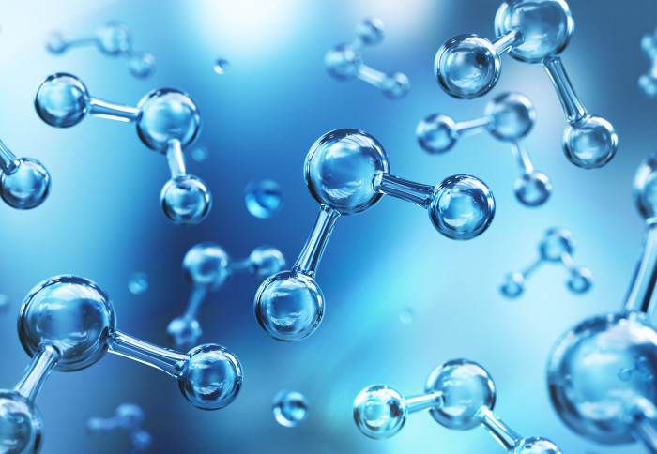
MEASUREMENT

Slide 3
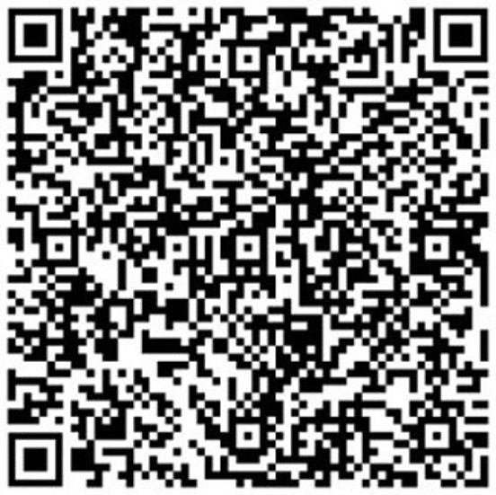
These tasks must be done:
Measuring water quality with the water analysis package: VISOCOLOR SCHOOL
completing the worksheet
sending the measurement data to the android APP (tablet or phone)
Creating the PowerPoint presentation (laptop) SWAP DIÁKOK – Measuring water quality – Fájlok – X team
The groups must be presented on Friday morning. (with PowerPoint)

Slide 4
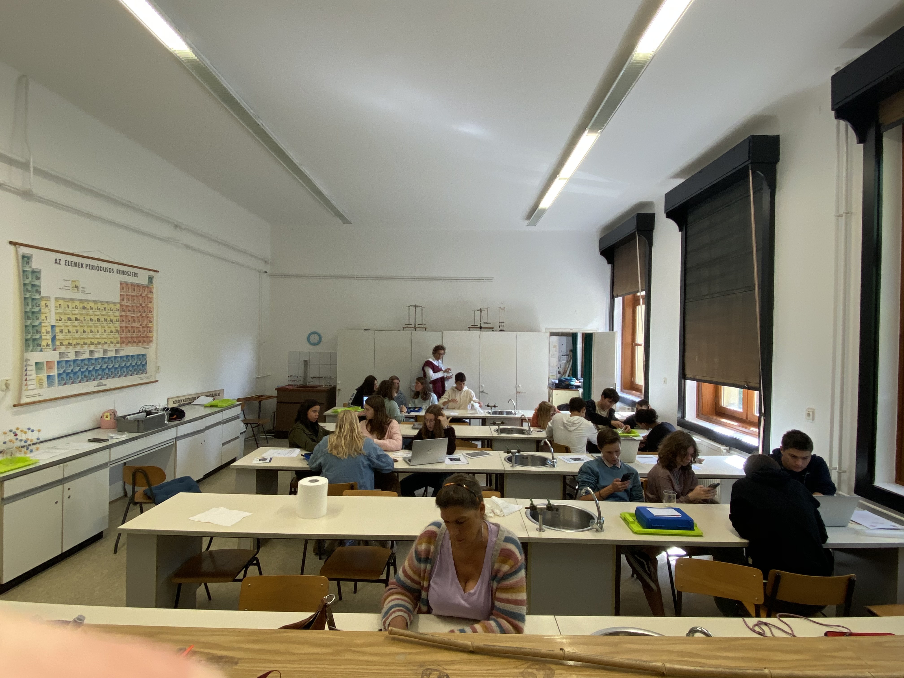
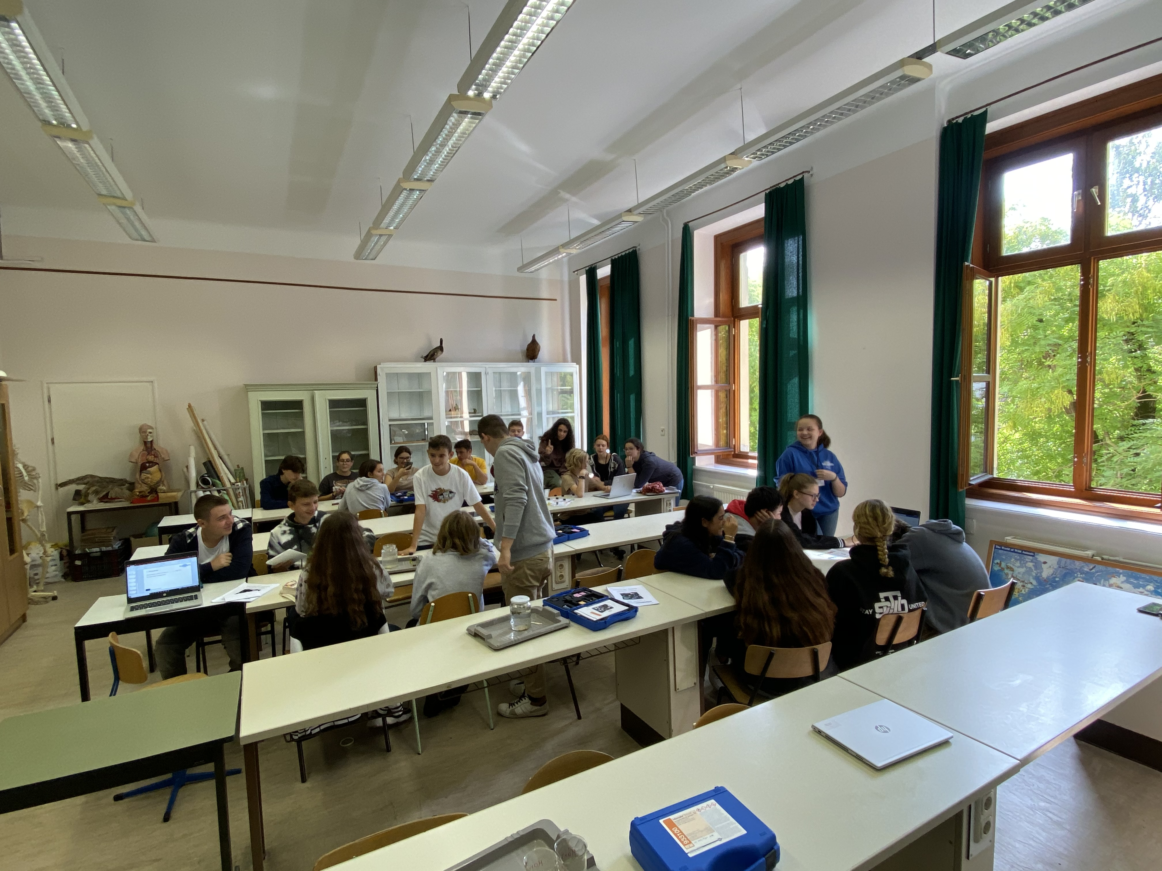

Slide 5
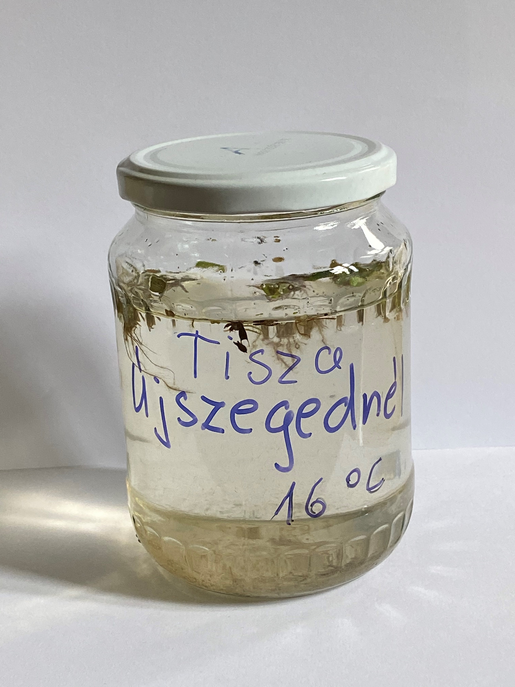
River Tisza between Szeged and Újszeged (dragon boat)
26/09/2022
Sampling site 1.:

Slide 6
Team’s name: 1 Újszeged
Names of students: Jef Gijsels
Estela Santos
Naiara Espejo
Sabela Romero
Basilis Floudas

Slide 7
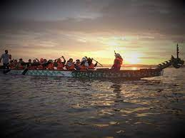
Pictures of the sampling location

Slide 8
1. Water temperature measurement
(at the time of sampling)
Water temperature: 16°C

Slide 9
2. Measuring the pH value of water
Pictures of the measurement (A)
Pictures of the measurement (B)

Slide 10
A: Measurement with pH test strips | B: Measurement using reagents
7 | 7
Is the water acidic, alkaline or neutral? neutral

Slide 11
3. Total hardness
Total water hardness: 9.1 °e 124,6 mg/L CaC0₃
Depending on the amount of calcium and magnesium salts, water is classified as hard or soft in different gradations:
Very soft: | 0-308 ^{O} e
Soft: | 5-8.8 ^{O} e
Medium hard: | 10-13.8 ^{O} e
Fairly hard: | 15⁰ +21.3 ^{O} e
Hard: | 22.5 - 37.5 ^{O} e
Very hard: | more than 37.5 ^{O} e

Slide 12
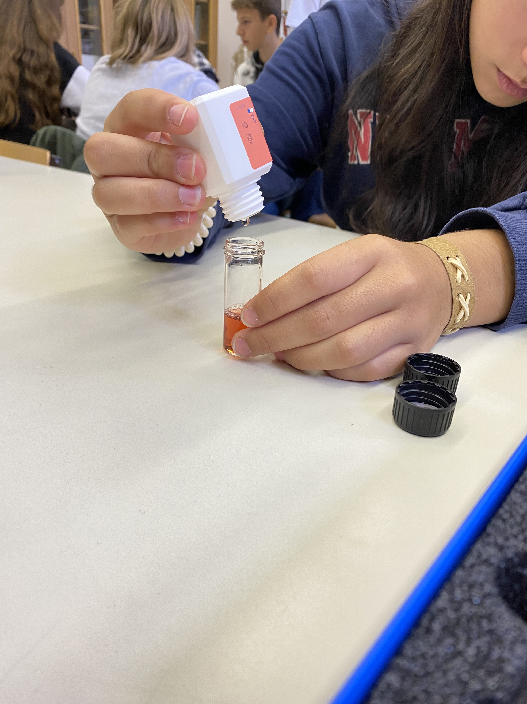
Pictures of the measurement

Slide 13
4. Ammonium
The ammonium content of water is: ……0…….. mg/L NH₄ ⁺
Pictures of the measurement:

Slide 14
5. Nitrate
The nitrate content of water is ……5…….… mg/L N0₃⁻
Pictures of the measurement:

Slide 15
6. Nitrite
The nitrite content of water is: ……0.02….. mg/L NO₂⁻
Pictures of the measurement:

Slide 16
7. Phosphate
The phospate content of water is: ……1.5….. mg/L PO₄³⁻
Pictures of the measurement:

Slide 17
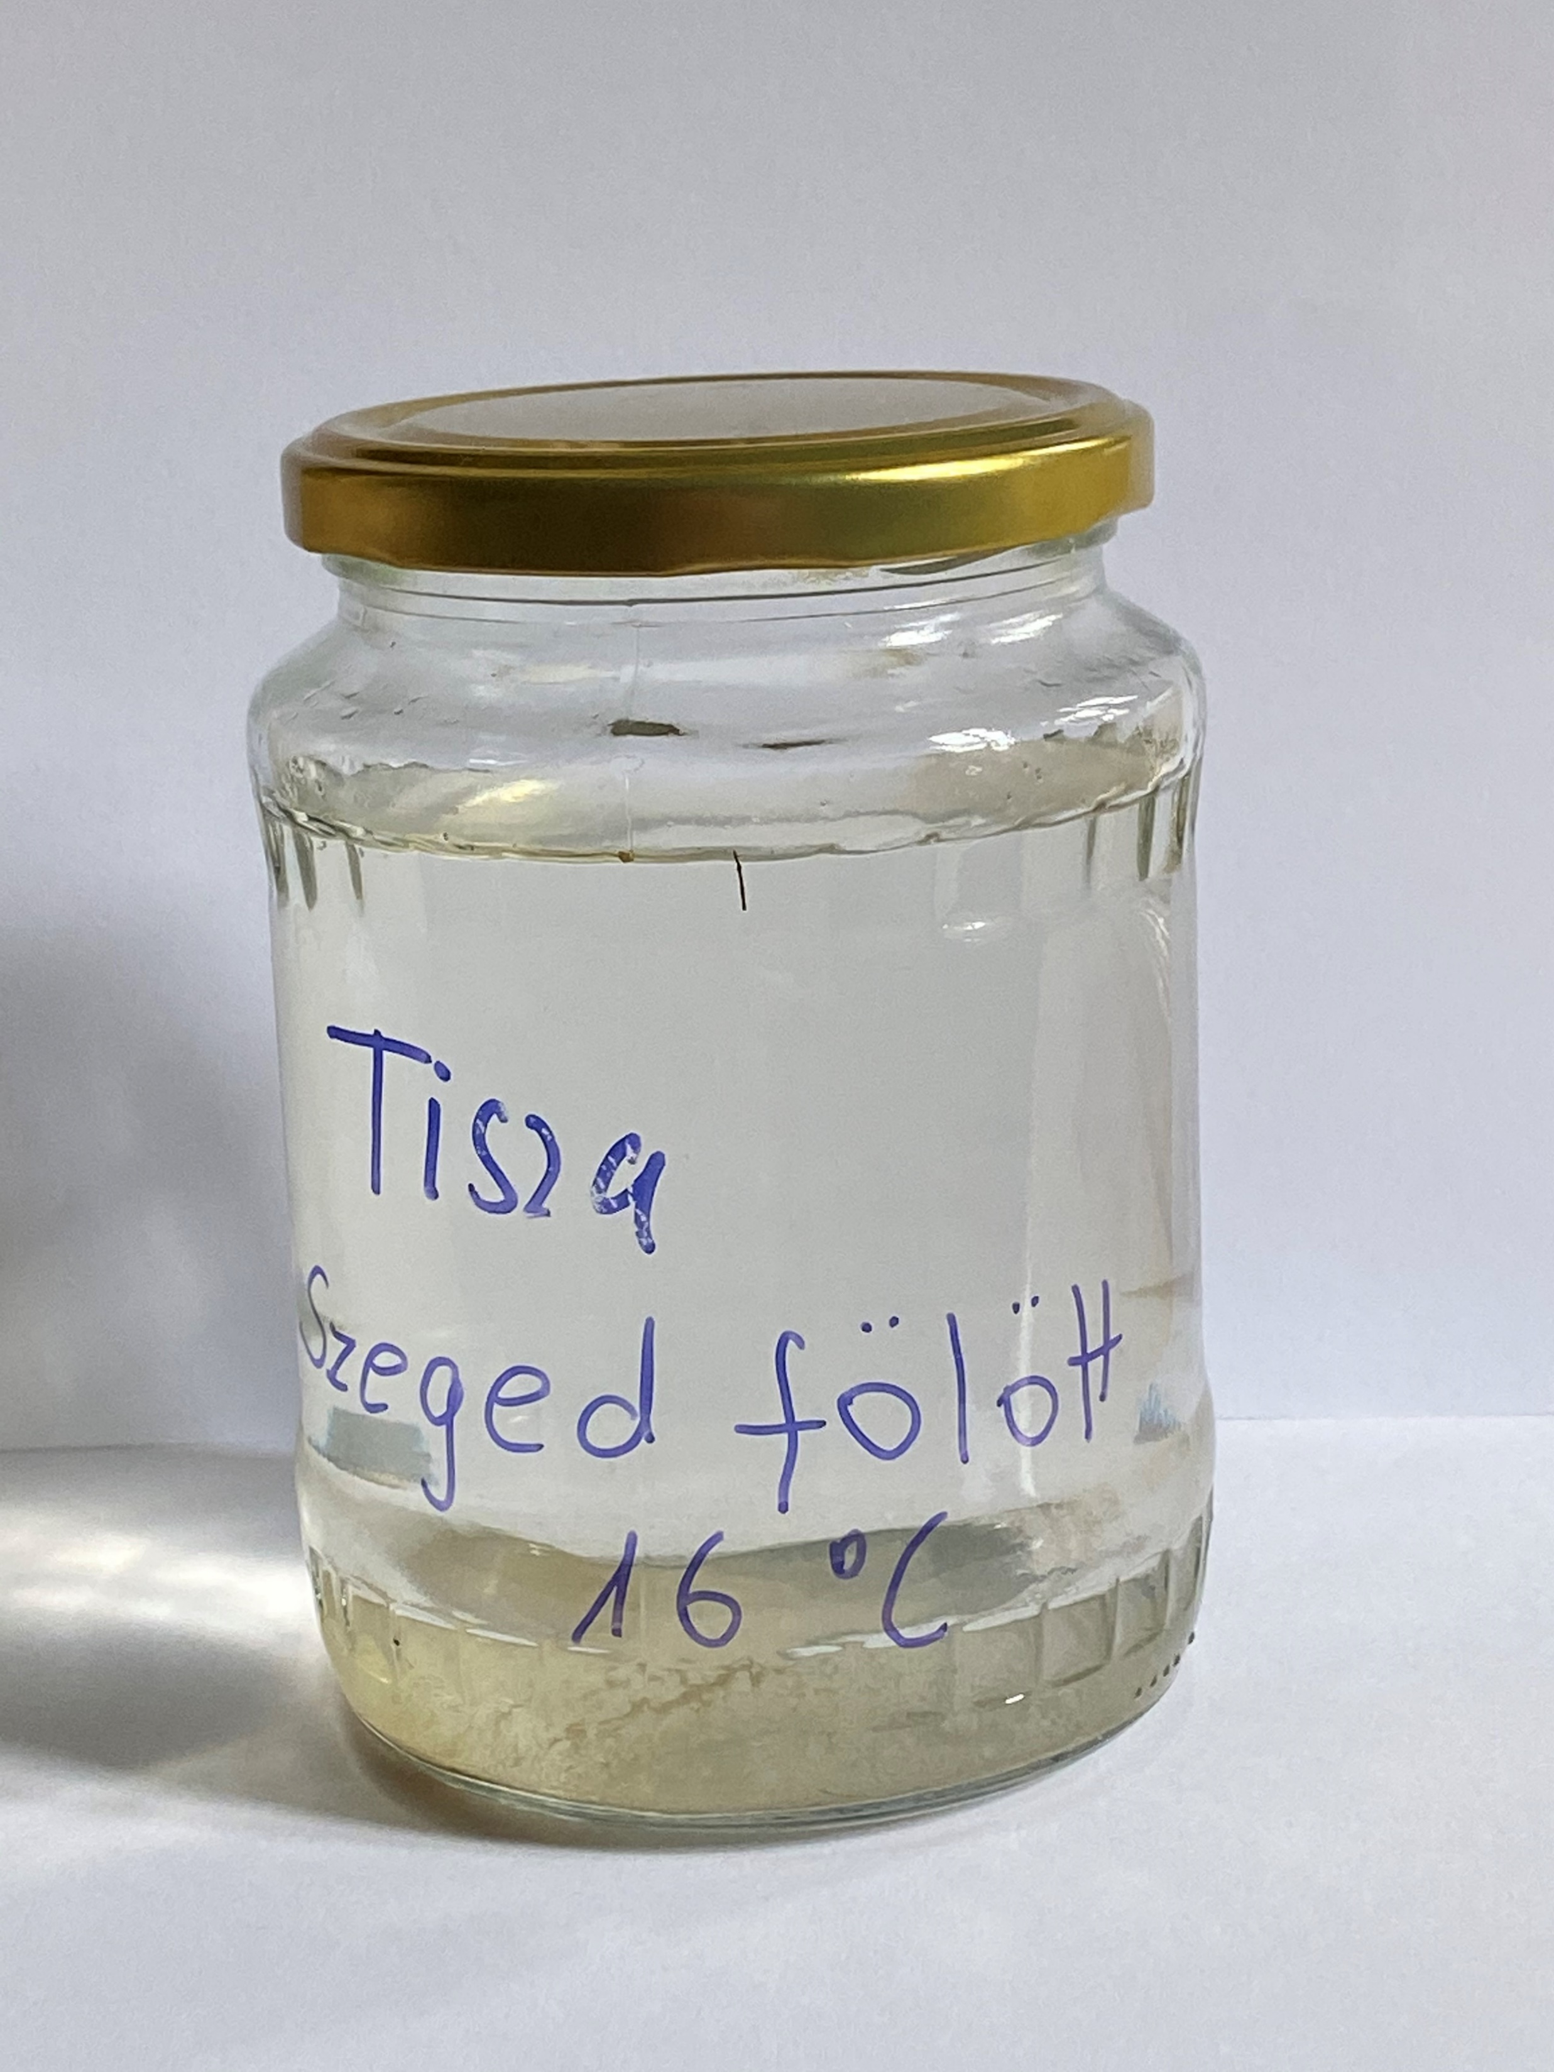
River Tisza Between Szeged and the Maros (dragon boat)
26/09/2022
Sampling site 2.:

Slide 18
Team’s name: 2
Names of students:
Mórocz Gergő
Katsanos Petros
Rau Maria-Christina
Shulla Zare
Andreas Bozios
Török Dávid

Slide 19
1. Water temperature measurement
(at the time of sampling)
Water temperature: 16°C

Slide 20
2. Measuring the pH value of water
Pictures of the measurement (A)
Pictures of the measurement (B)

Slide 21
A: Measurement with pH test strips | B: Measurement using reagents
7 | 7
Is the water acidic, alkaline or neutral? The water is neutral

Slide 22
3. Total hardness
Total water hardness: 10.4 °e 142,4 mg/L CaC0₃
Depending on the amount of calcium and magnesium salts, water is classified as hard or soft in different gradations:
Very soft: | 0-308 ^{O} e
Soft: | 5-8.8 ^{O} e
Medium hard:x | 10-13.8 ^{O} e
Fairly hard: | 15⁰ +21.3 ^{O} e
Hard: | 22.5 - 37.5 ^{O} e
Very hard: | more than 37.5 ^{O} e

Slide 23
4. Ammonium
The ammonium content of water is: 0 mg/L NH₄ ⁺
Pictures of the measurement:

Slide 24
5. Nitrate
The nitrate content of water is 5 mg/L N0₃⁻
Pictures of the measurement:

Slide 25
6. Nitrite
The nitrite content of water is: 0.02 mg/L NO₂⁻
Pictures of the measurement:

Slide 26
7. Phosphate
The phospate content of water is: 1.5 mg/L PO₄³⁻
Pictures of the measurement:

Slide 27
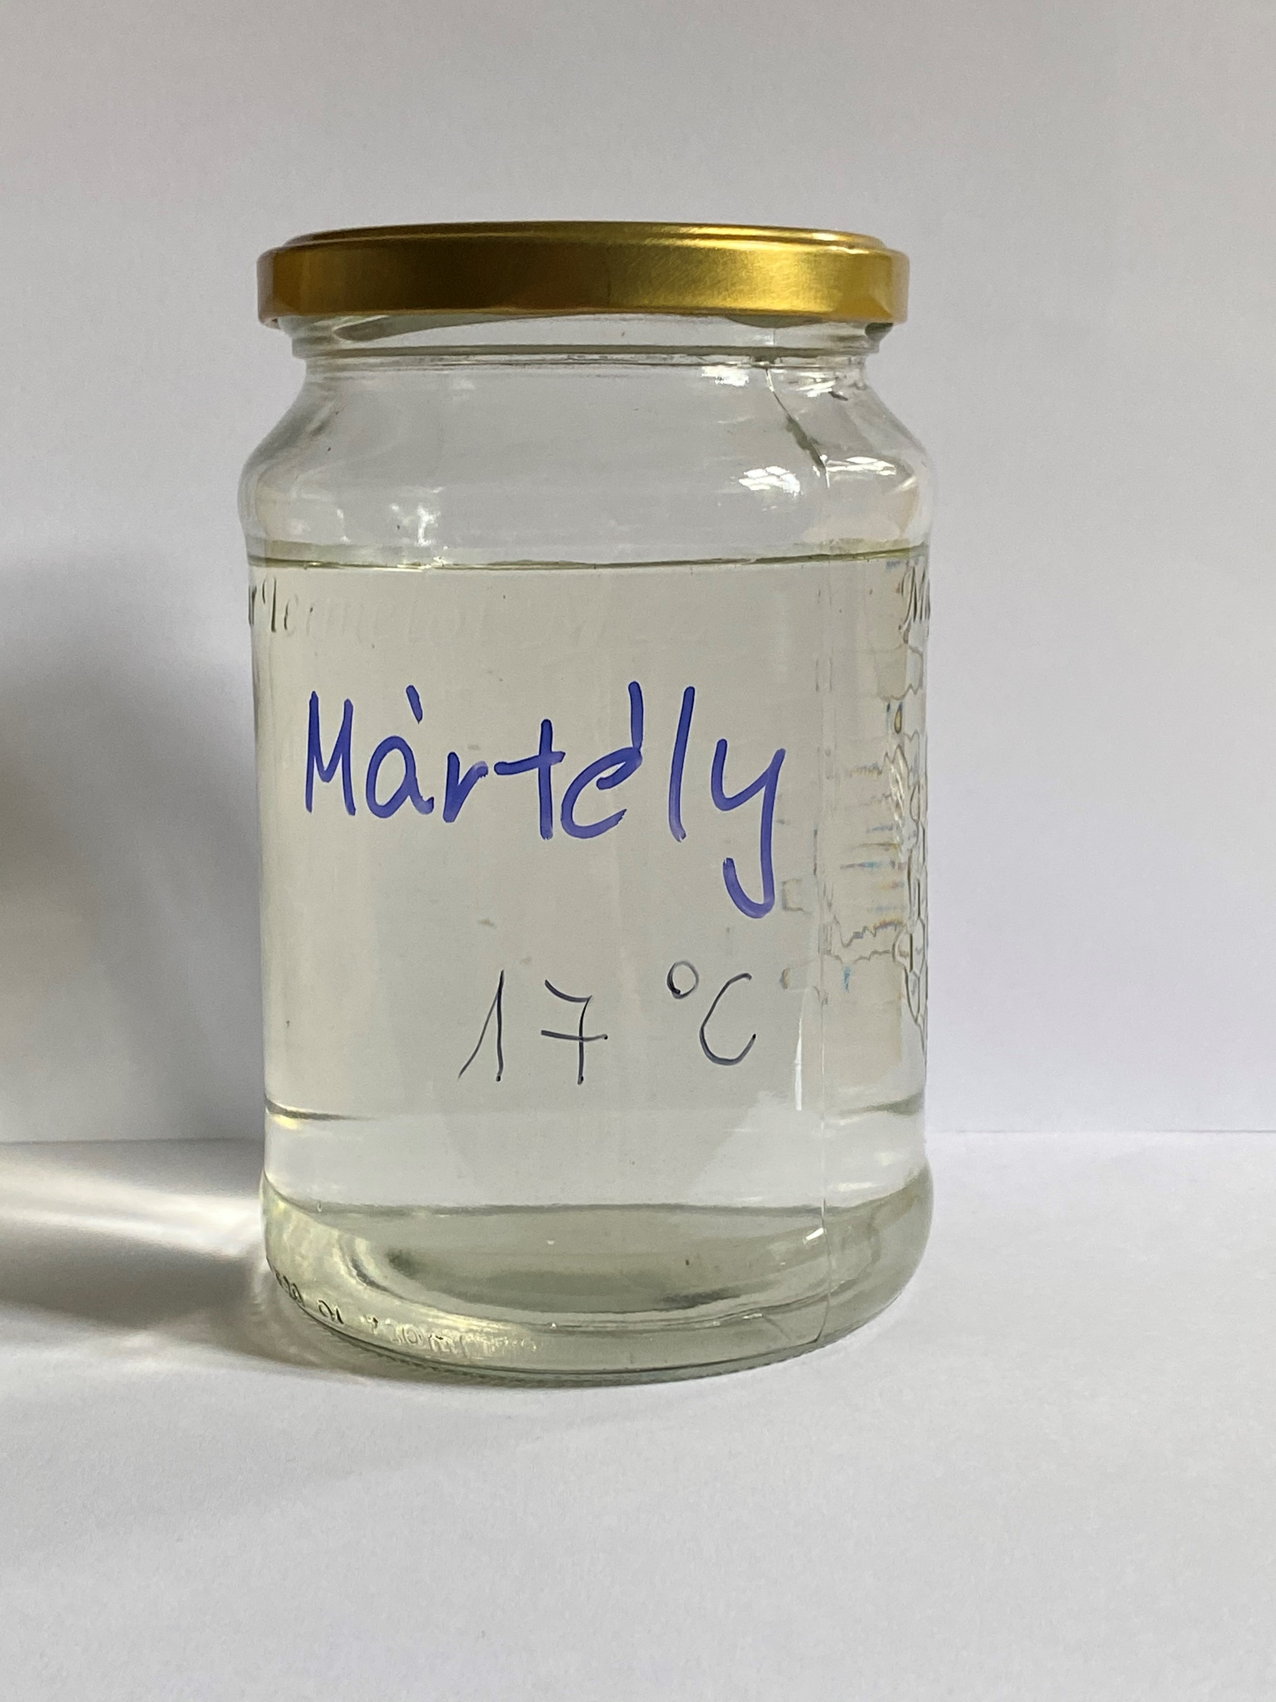
MÁRTÉLY- Cut-off Tisza River Bend
27/09/2022
Sampling site 3.:

Slide 28
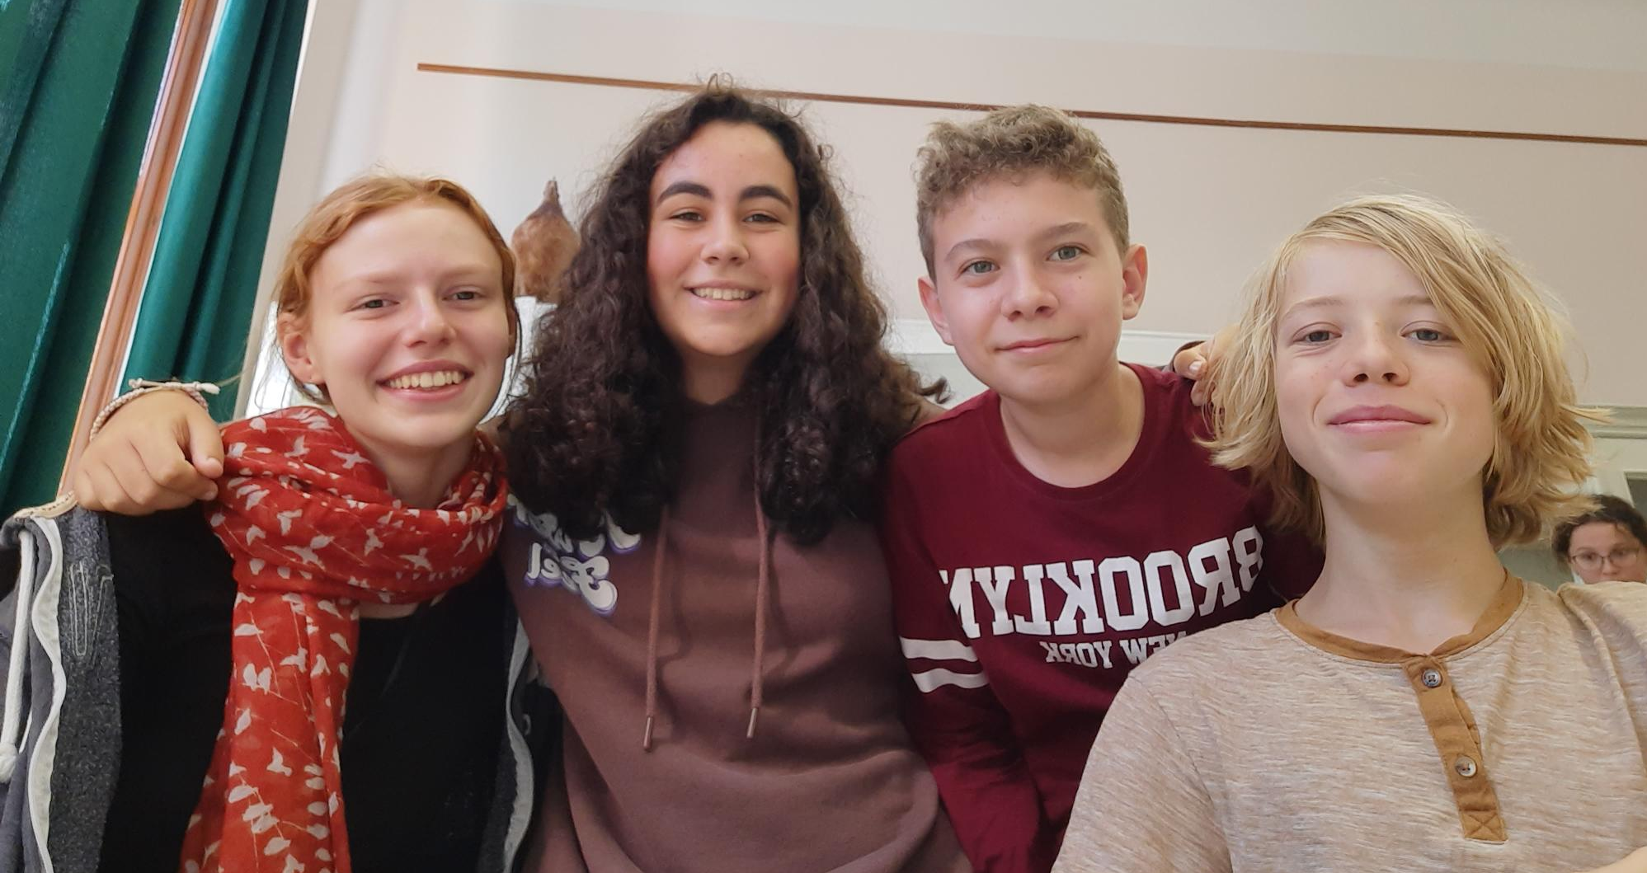
Team’s name: Mártély 3
Names of students:
Zoé Száka
Noa González
Josse Remans
Lambros Psarogiannis

Slide 29
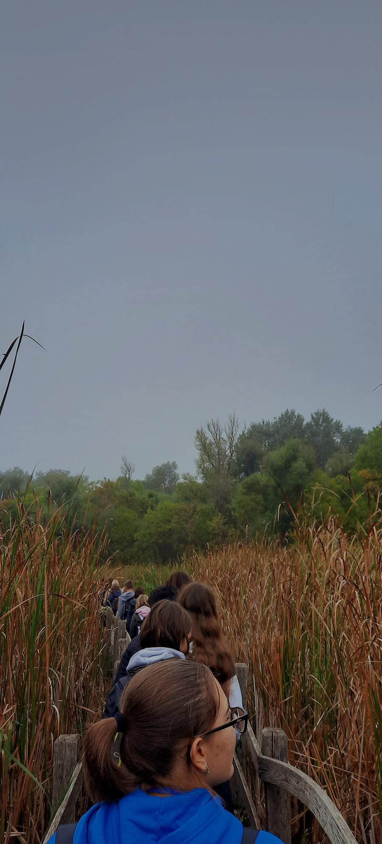
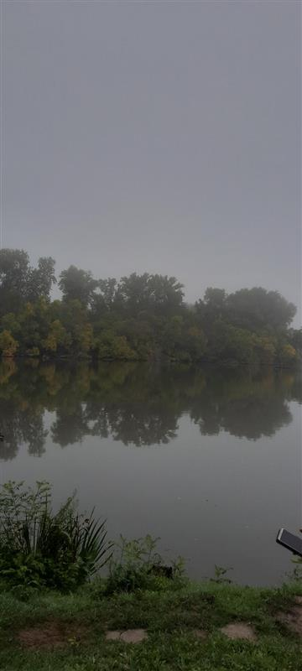
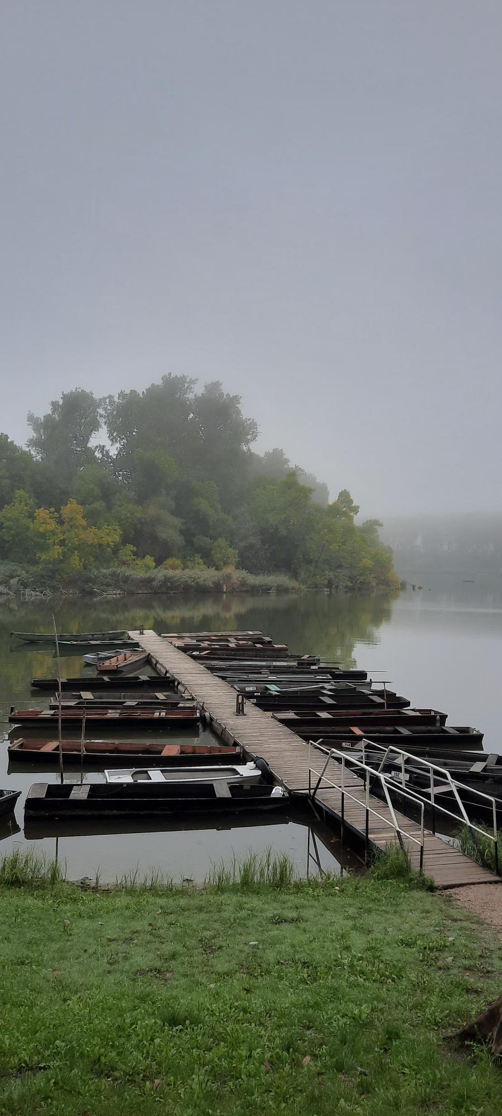
Pictures of the sampling location

Slide 30
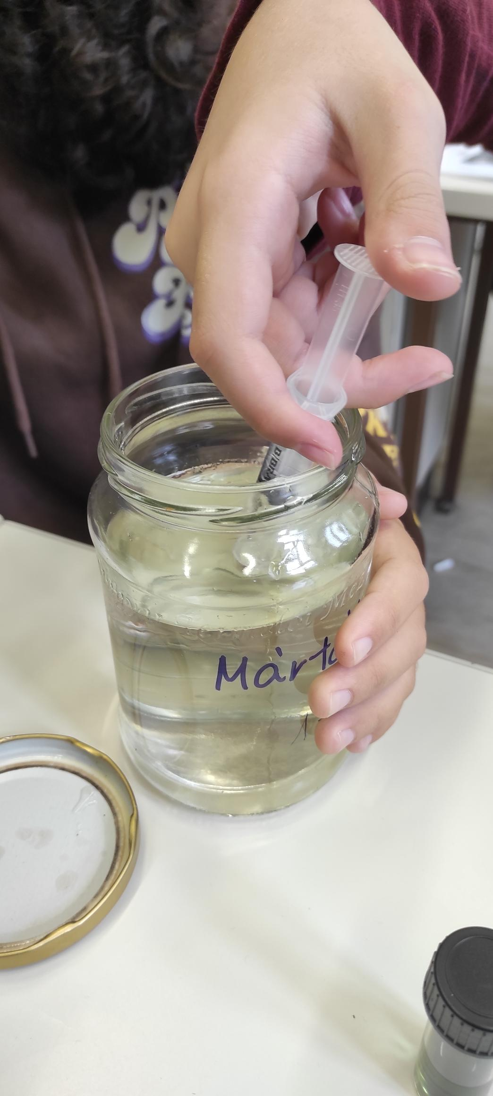
1. Water temperature measurement
(at the time of sampling)
Water temperature: 17 °C

Slide 31
2. Measuring the pH value of water
Pictures of the measurement (A)
Pictures of the measurement (B)

Slide 32
A: Measurement with pH test strips | B: Measurement using reagents
7,5 | 8
Is the water acidic, alkaline or neutral? Alkiline

Slide 33
3. Total hardness
Total water hardness: 10 drops, 13 °e 178 mg/L CaC0₃
Depending on the amount of calcium and magnesium salts, water is classified as hard or soft in different gradations:
Very soft: | 0-308 ^{O} e
Soft: | 5-8.8 ^{O} e
Medium hard: | 10-13.8 ^{O} e
Fairly hard: | 15⁰ +21.3 ^{O} e
Hard: | 22.5 - 37.5 ^{O} e
Very hard: | more than 37.5 ^{O} e

Slide 34
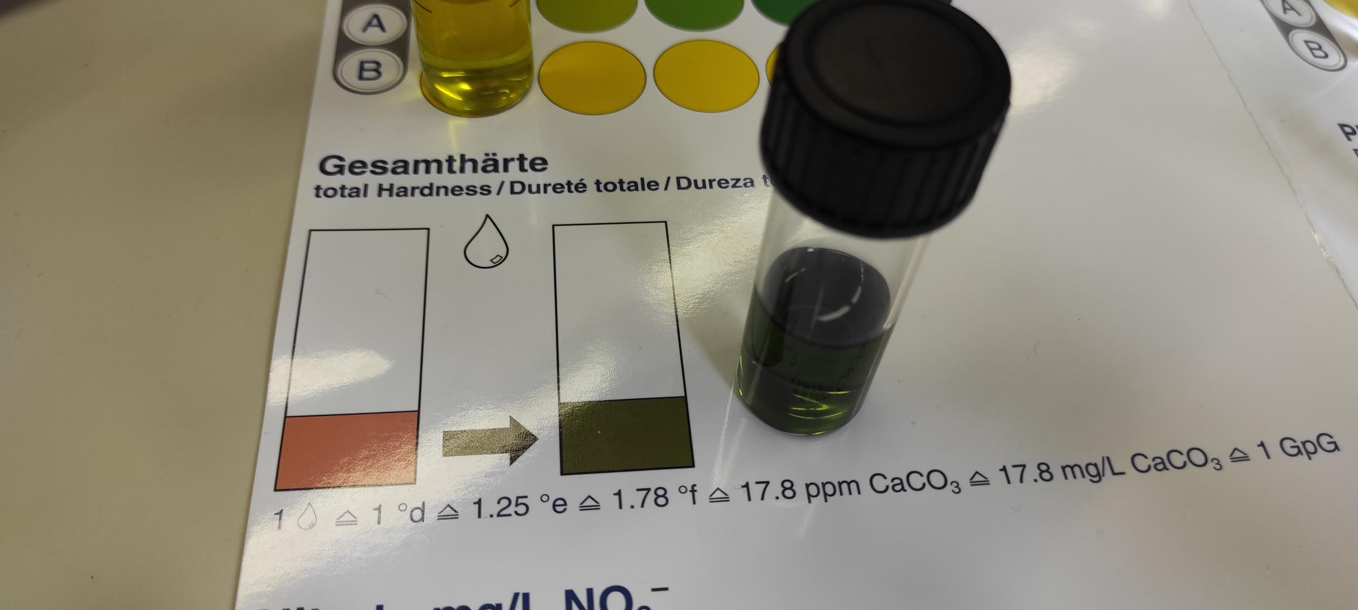
Total hardness

Slide 35
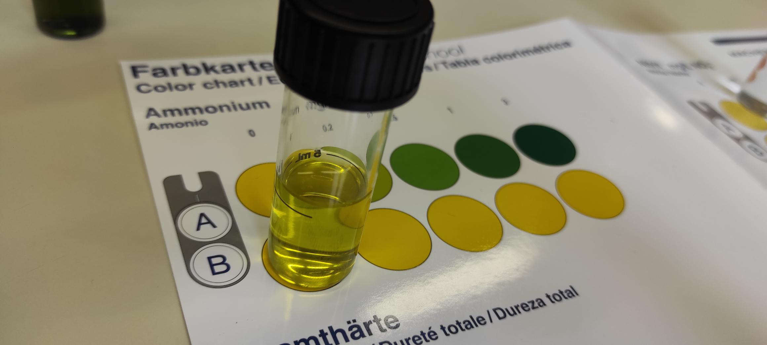
4. Ammonium
The ammonium content of water is: 0 mg/L NH₄ ⁺
Pictures of the measurement:

Slide 36
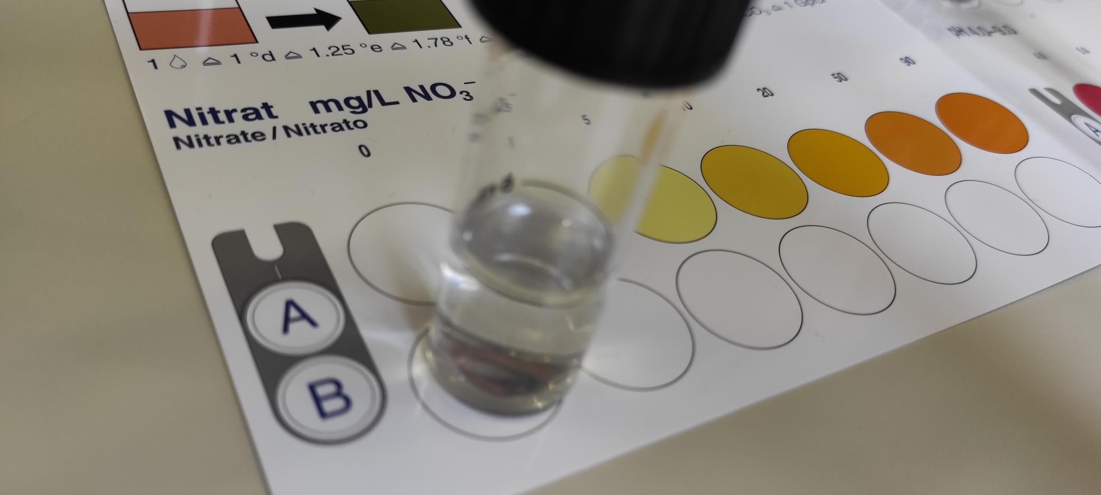
5. Nitrate
The nitrate content of water is: 0 mg/L N0₃⁻
Pictures of the measurement:

Slide 37
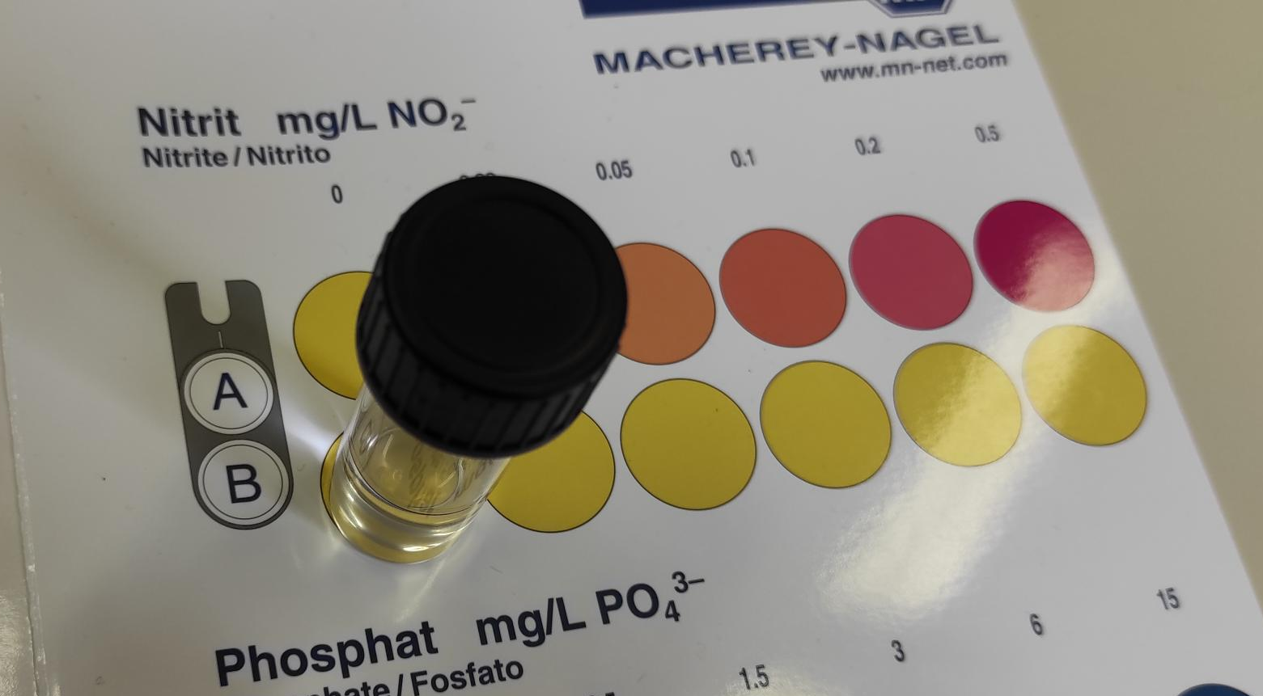
6. Nitrite
The nitrite content of water is: 0 mg/L NO₂⁻
Pictures of the measurement:

Slide 38
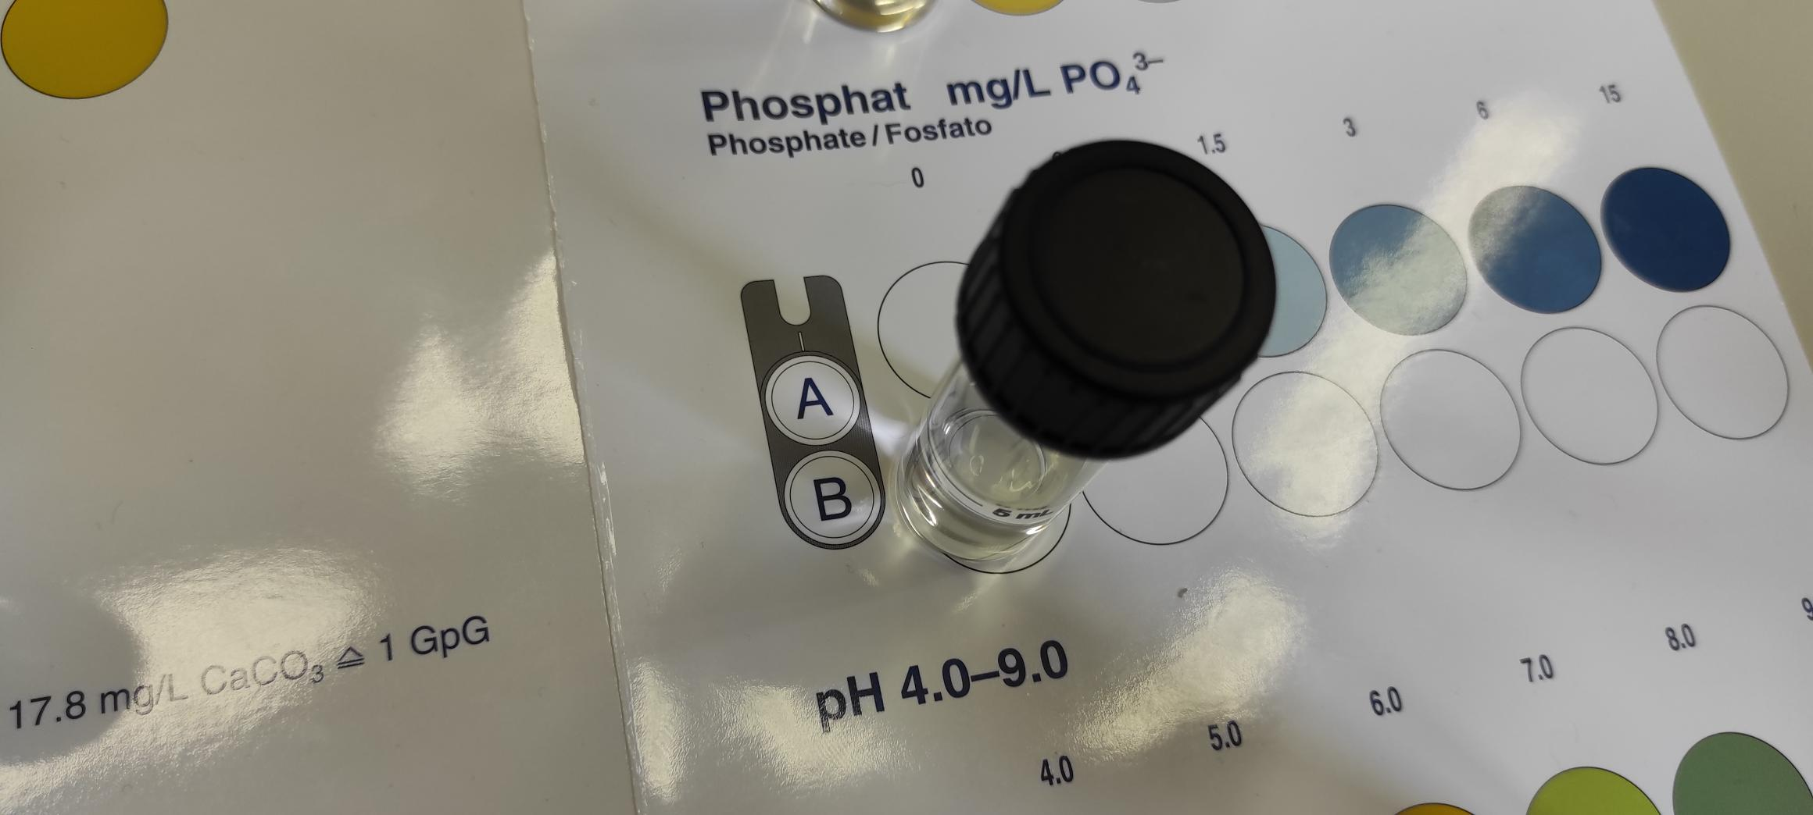
7. Phosphate
The phospate content of water is: 0 mg/L PO₄³⁻
Pictures of the measurement:

Slide 39
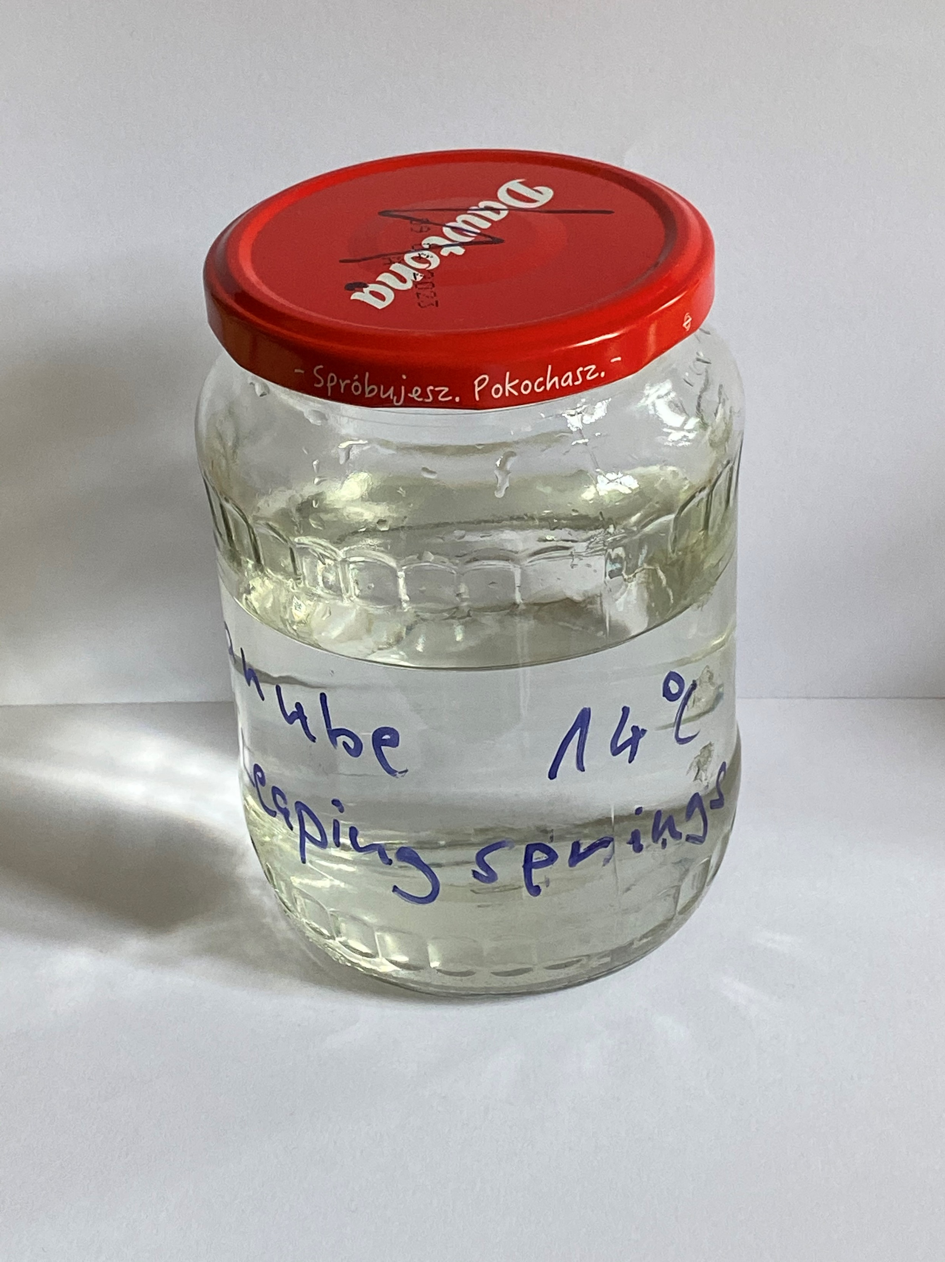
River Danube (Budapest)
28/09/2022
Sampling site 4.:

Slide 40
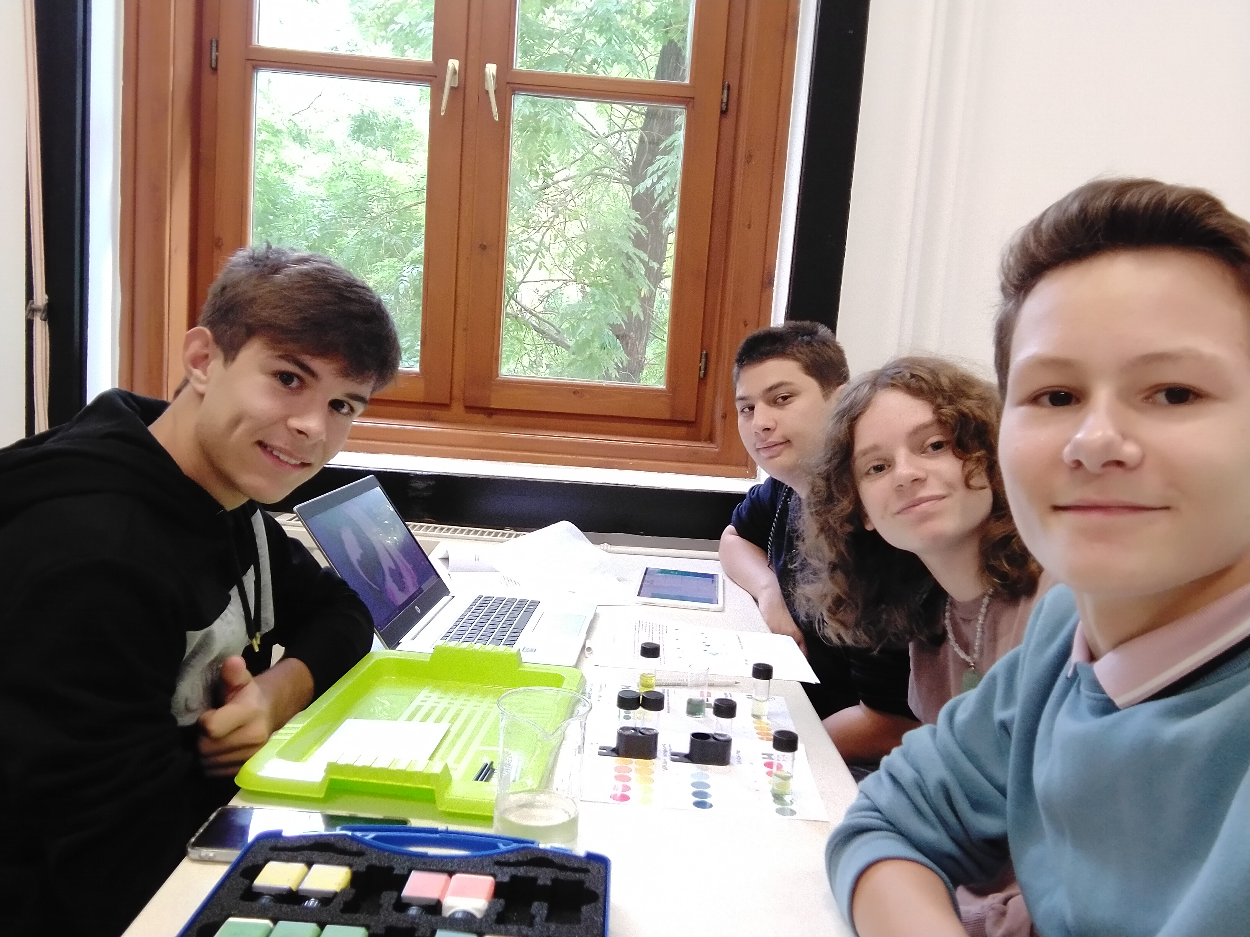
Team’s name: 4
Names of students: Nina, Kobe, Nico, Tamás

Slide 41
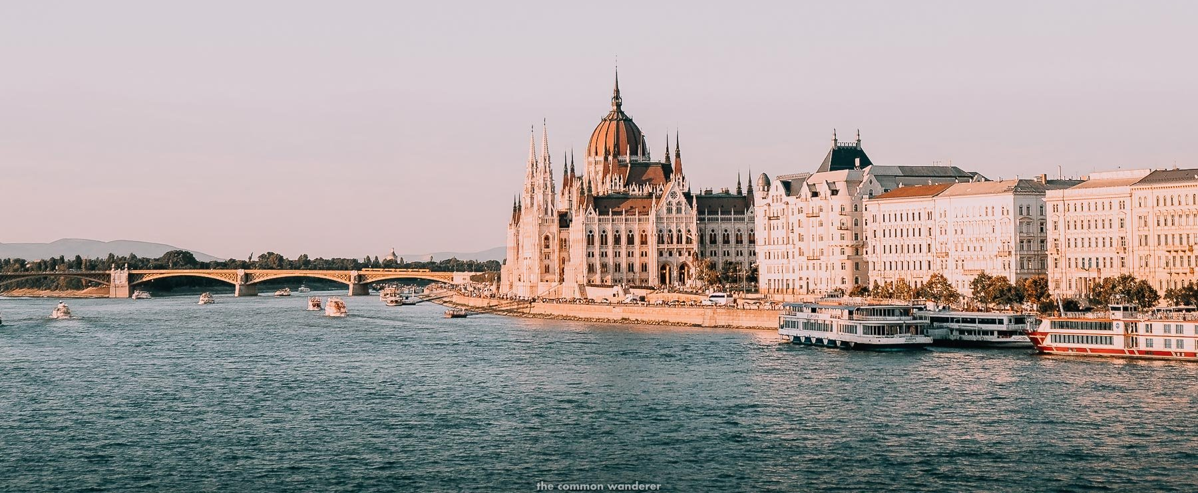
Pictures of the sampling location

Slide 42
Measurement result of the water sample
The water is between fairly hard anf medium hard, it has close to zero ammonium in it, and it has 5mg/L N0₃-.

Slide 43
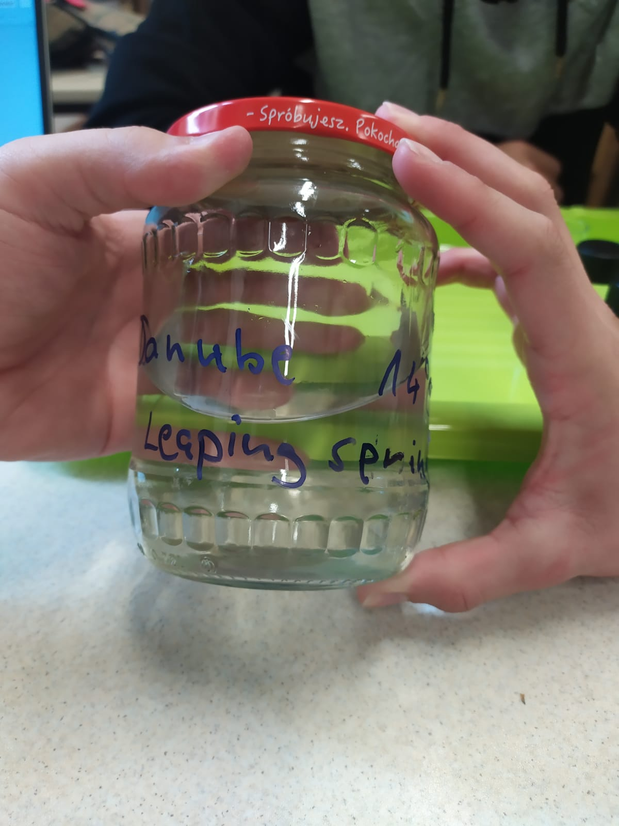
1. Water temperature measurement
(at the time of sampling)
Water temperature: 14°C

Slide 44
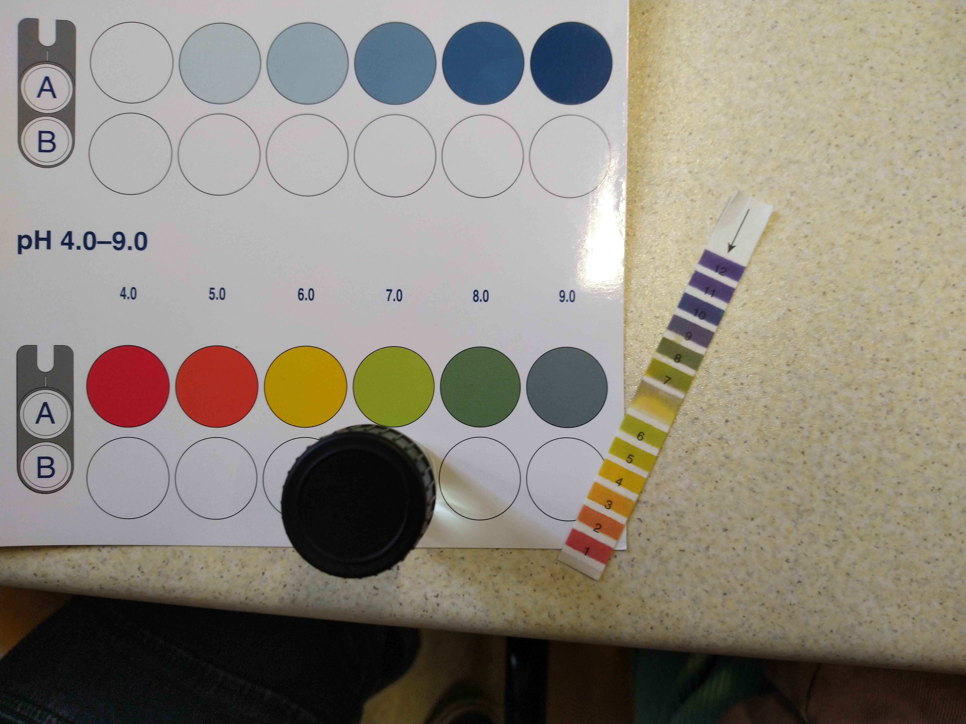
2. Measuring the pH value of water
Pictures of the measurement (A)
Pictures of the measurement (B)

Slide 45
A: Measurement with pH test strips | B: Measurement using reagents
7,5 | 7,5
Is the water acidic, alkaline or neutral? Alkaine

Slide 46
3. Total hardness
Total water hardness: 14.3 °e 195.8 mg/L CaC0₃
Depending on the amount of calcium and magnesium salts, water is classified as hard or soft in different gradations:
Very soft: | 0-308 ^{O} e
Soft: | 5-8.8 ^{O} e
Medium hard: | 10-13.8 ^{O} e
Fairly hard: | 15⁰ +21.3 ^{O} e
Hard: | 22.5 - 37.5 ^{O} e
Very hard: | more than 37.5 ^{O} e

Slide 47
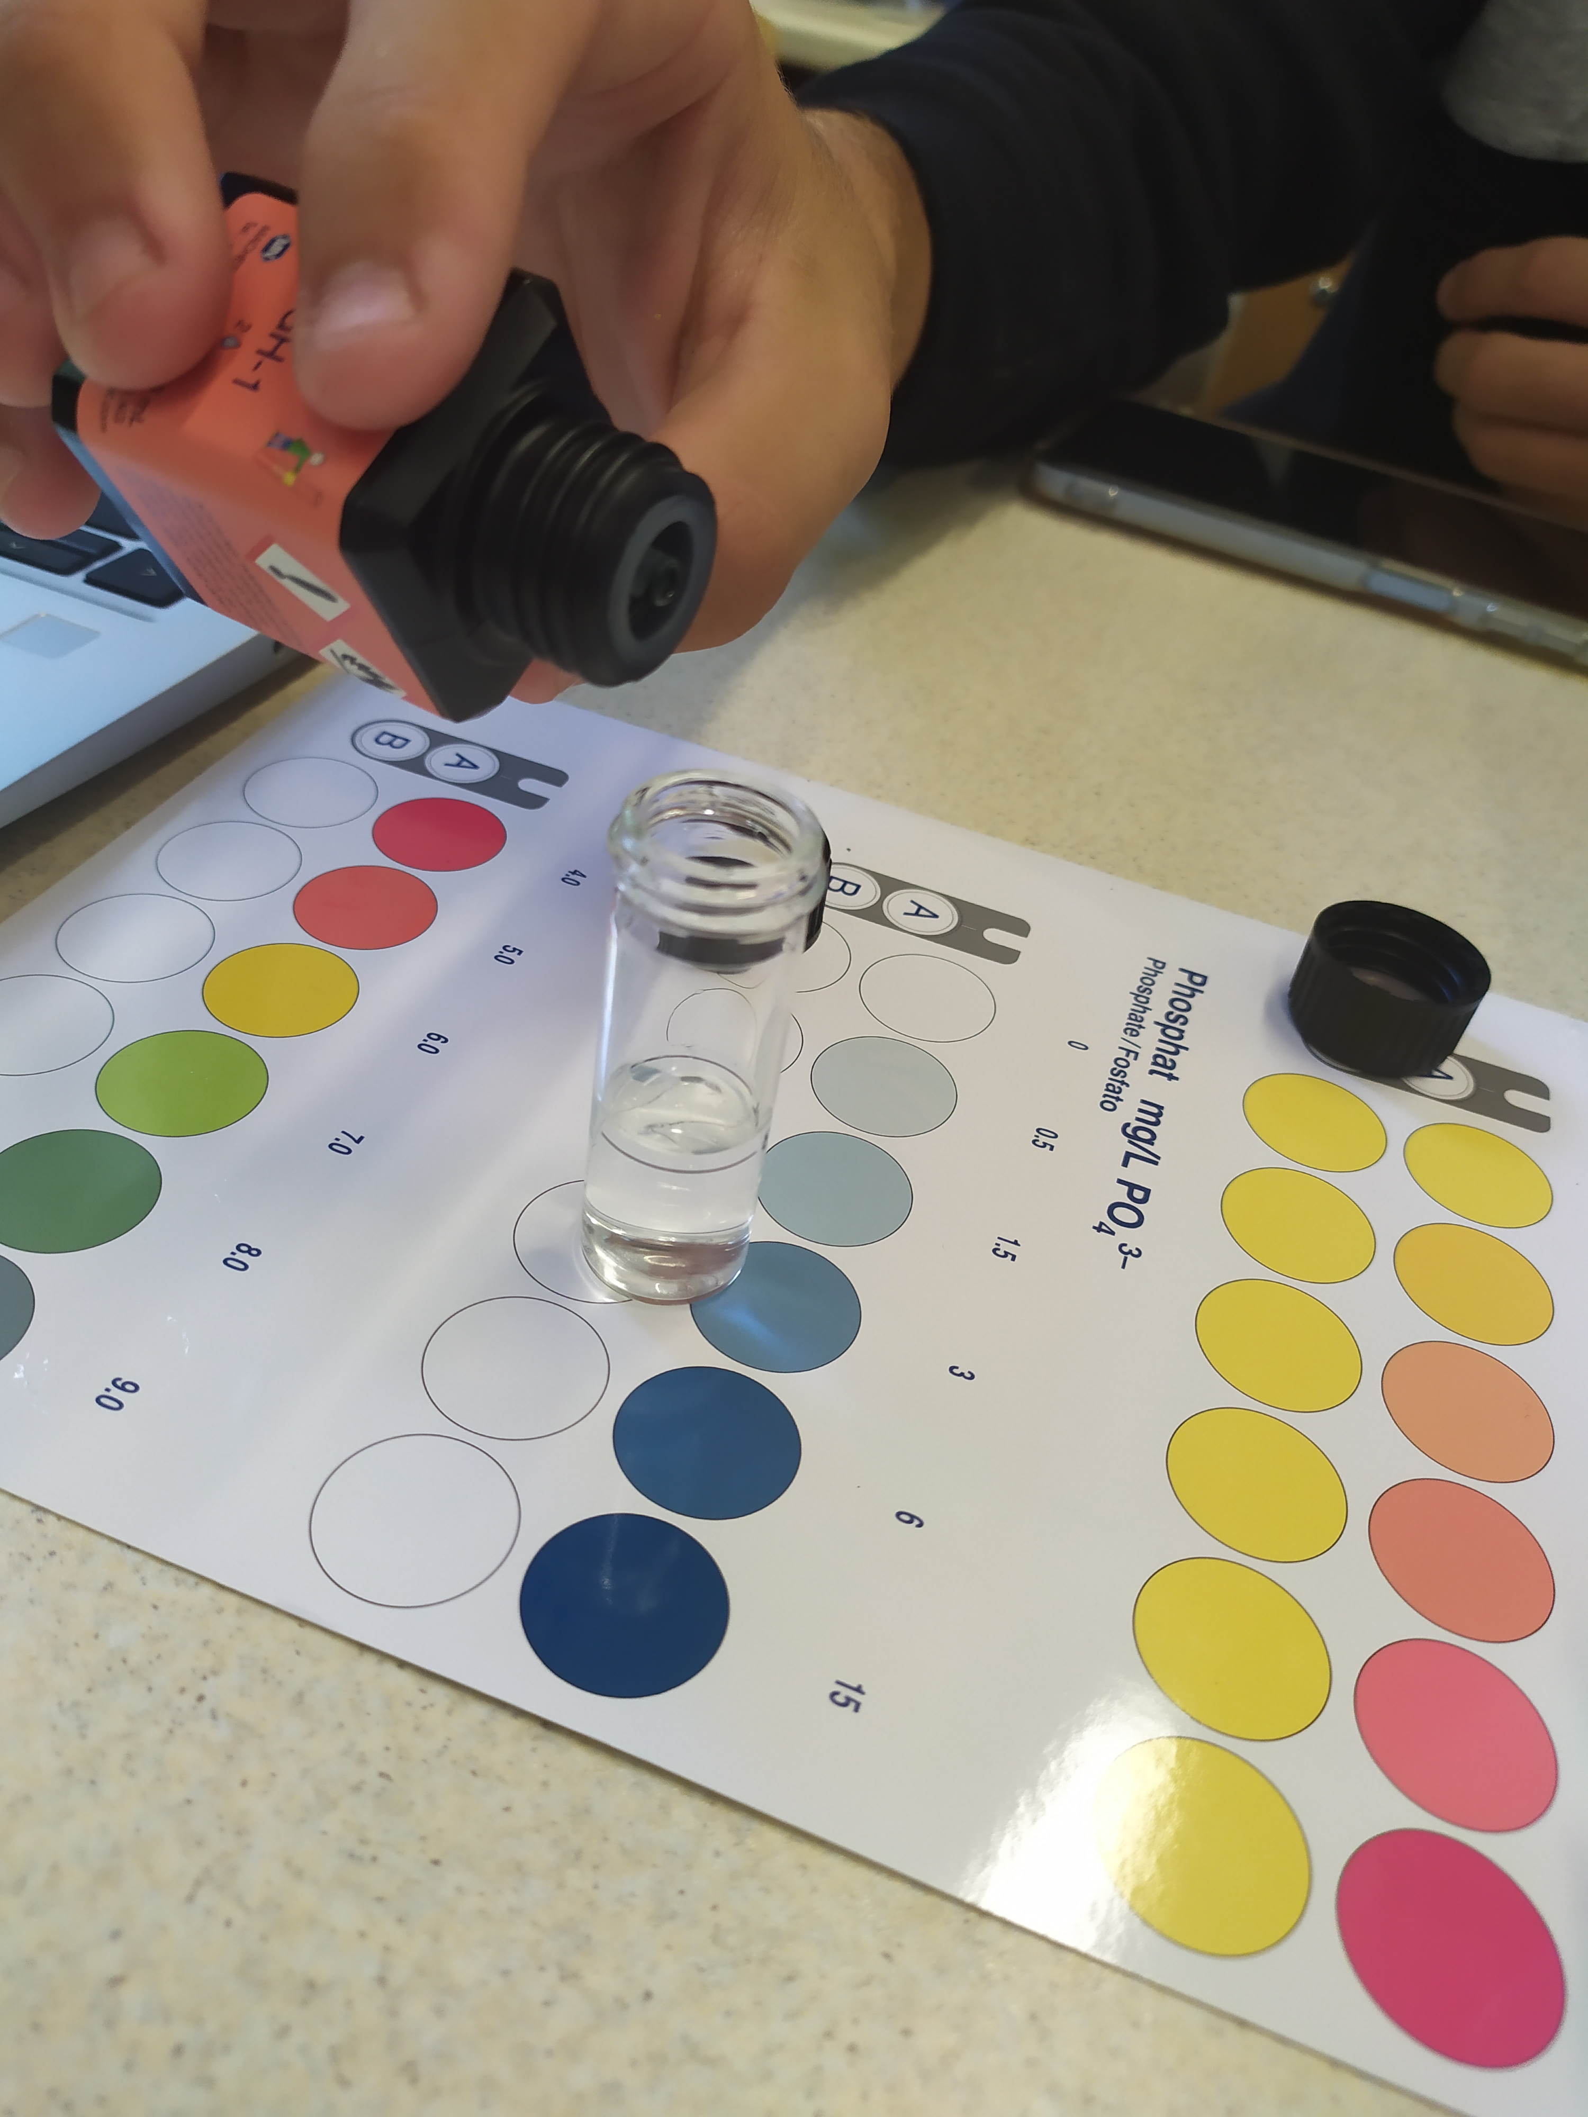
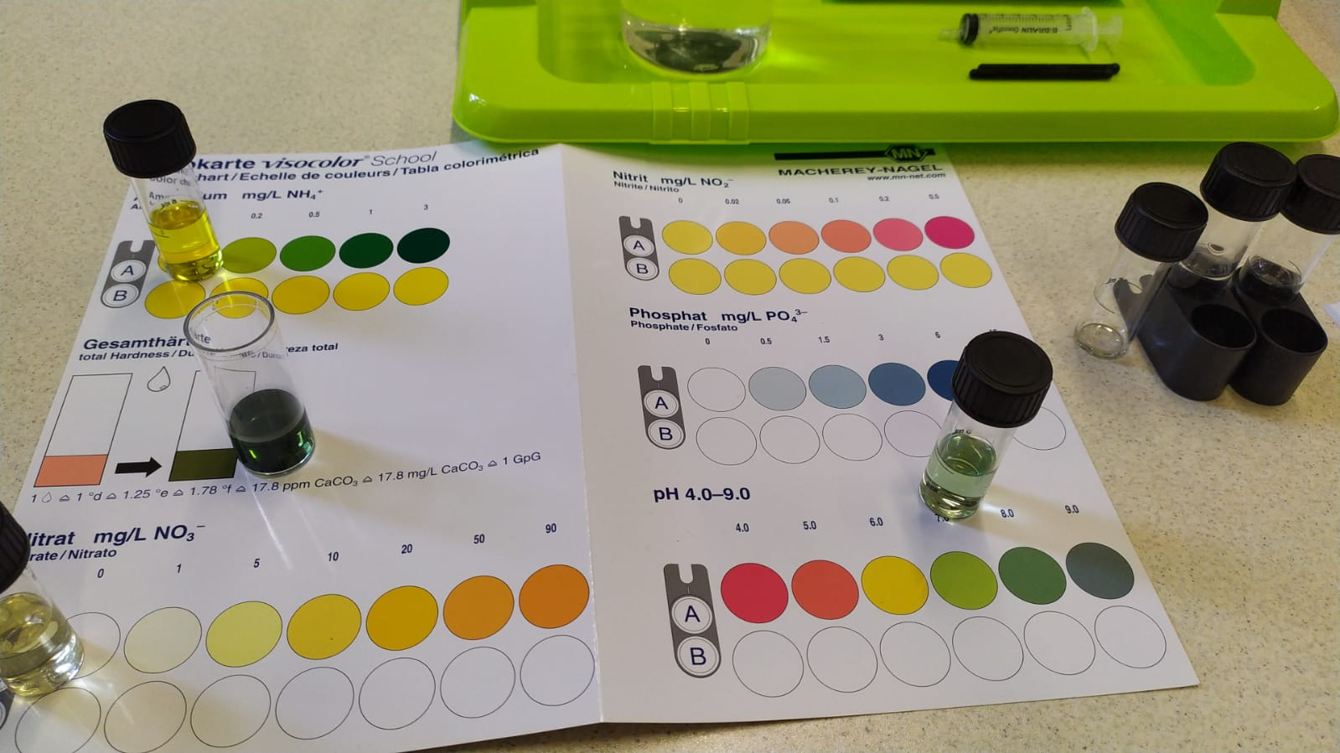
Pictures of the measurement

Slide 48
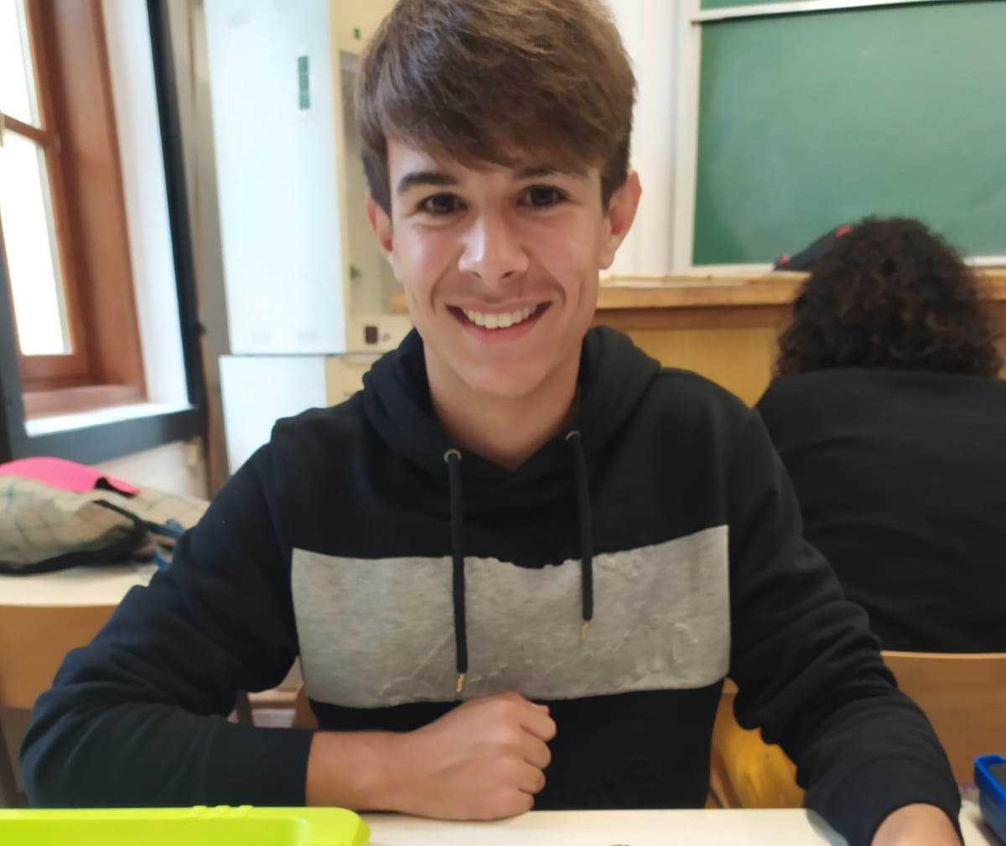
4. Ammonium
The ammonium content of water is: 0 mg/L NH₄ ⁺
Pictures of the measurement:

Slide 49
5. Nitrate
The nitrate content of water is 5 mg/L N0₃⁻

Slide 50
6. Nitrite
The nitrite content of water is: 0,02 mg/L NO₂⁻
Nitrite is bad but we have a very small amount
-> it causes weakness, dizziness and fatigue (toxic)

Slide 51
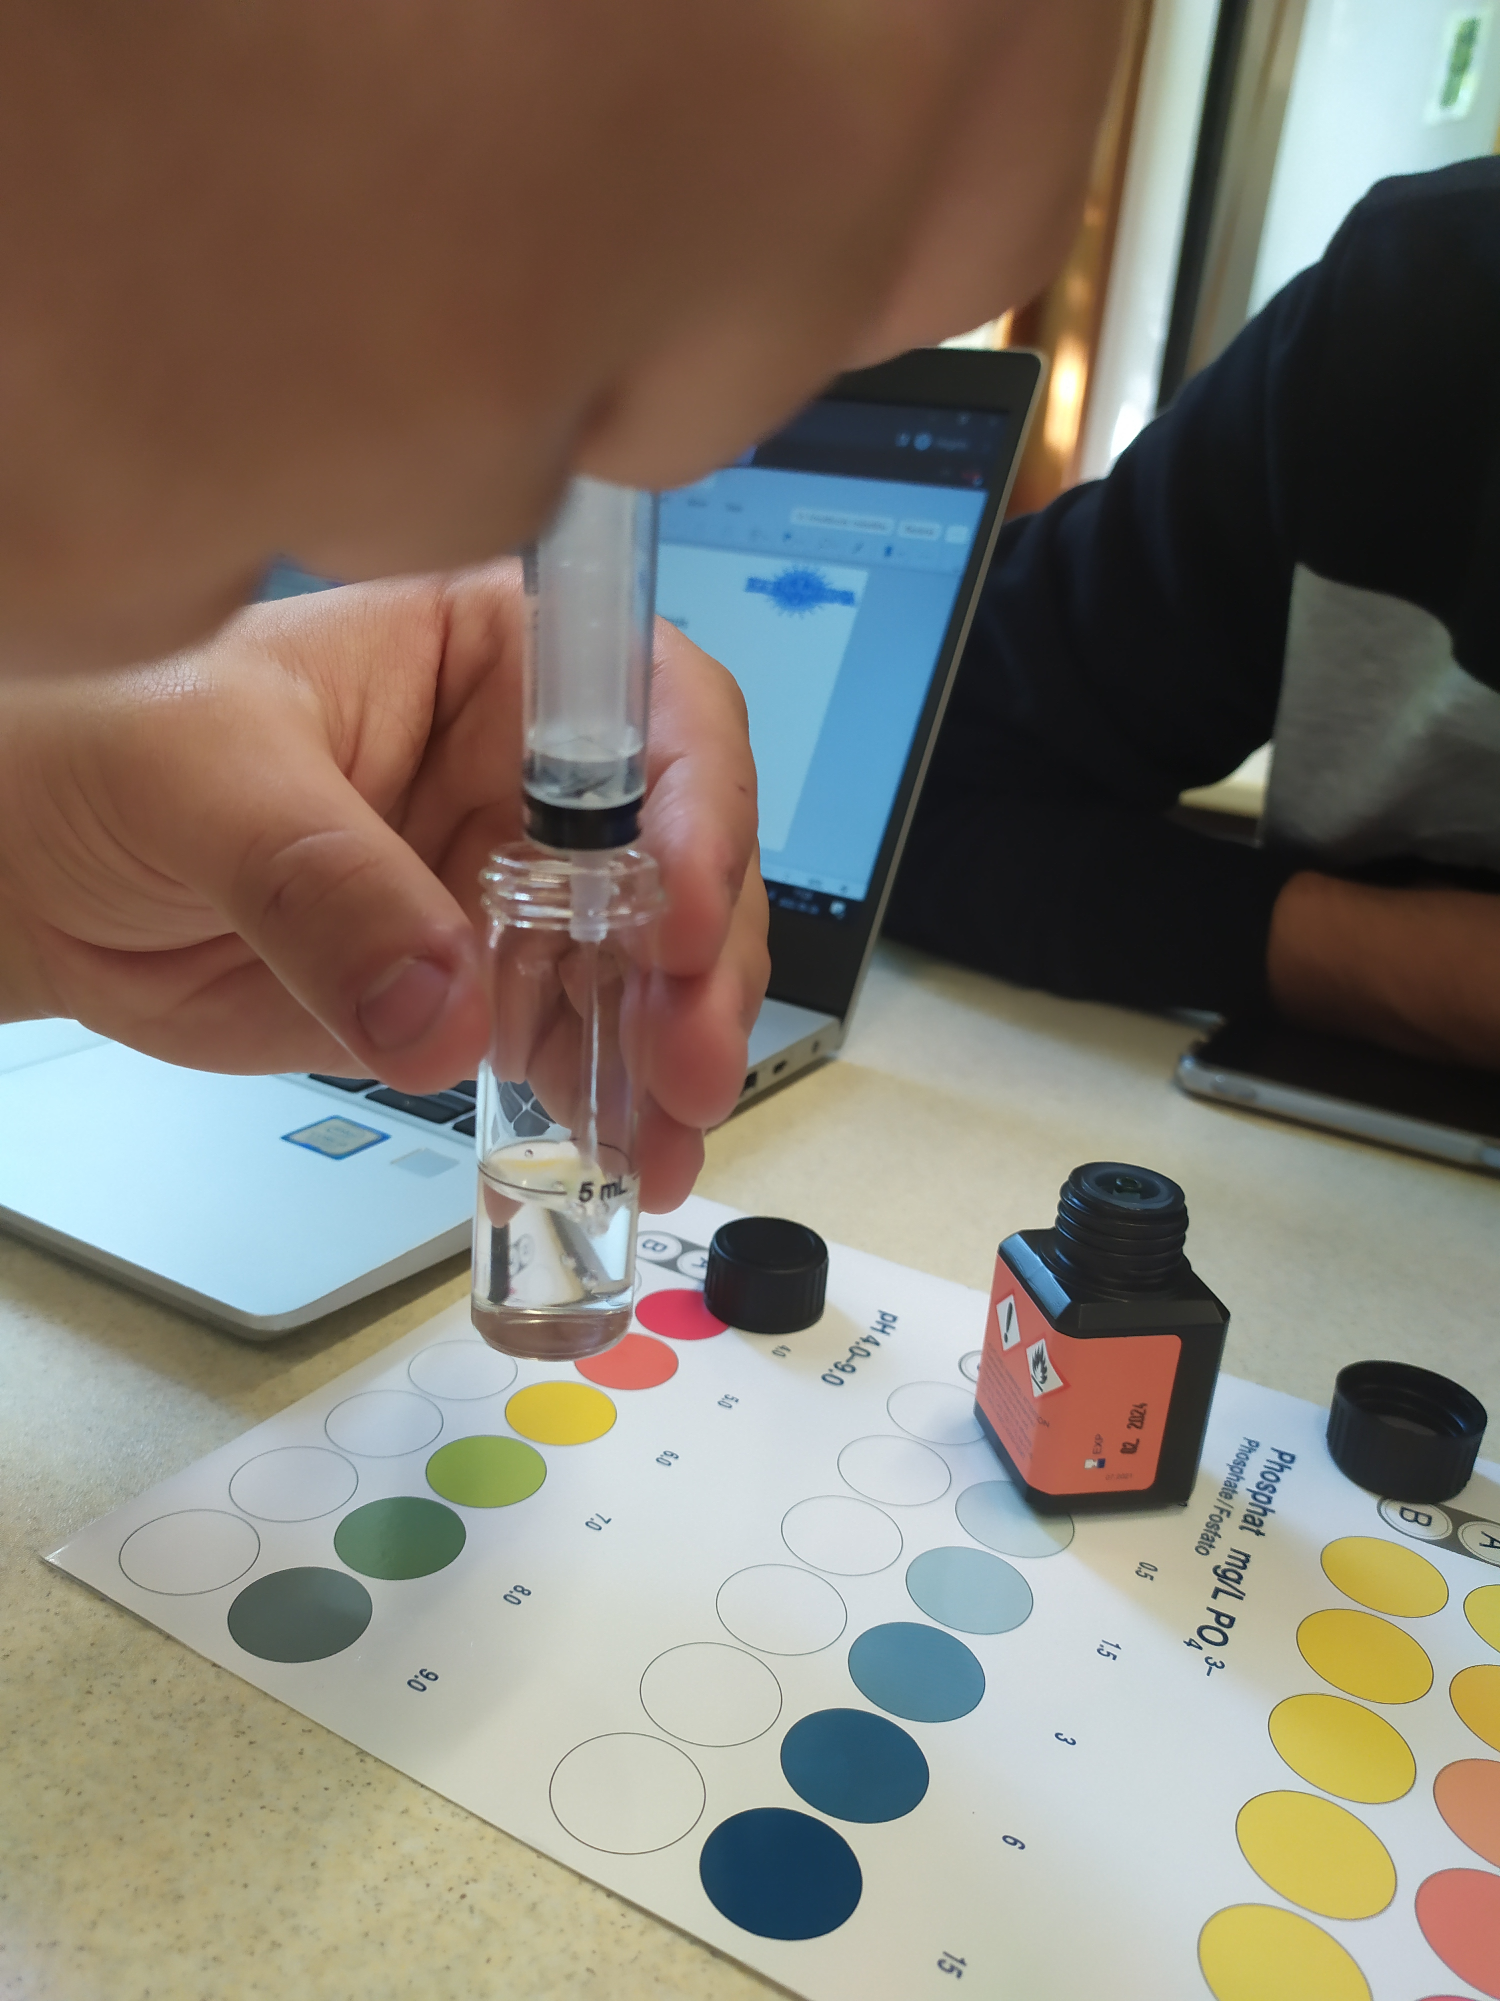
7. Phosphate
The phospate content of water is: 0 mg/L PO₄³⁻
Pictures of the measurement:

Slide 52
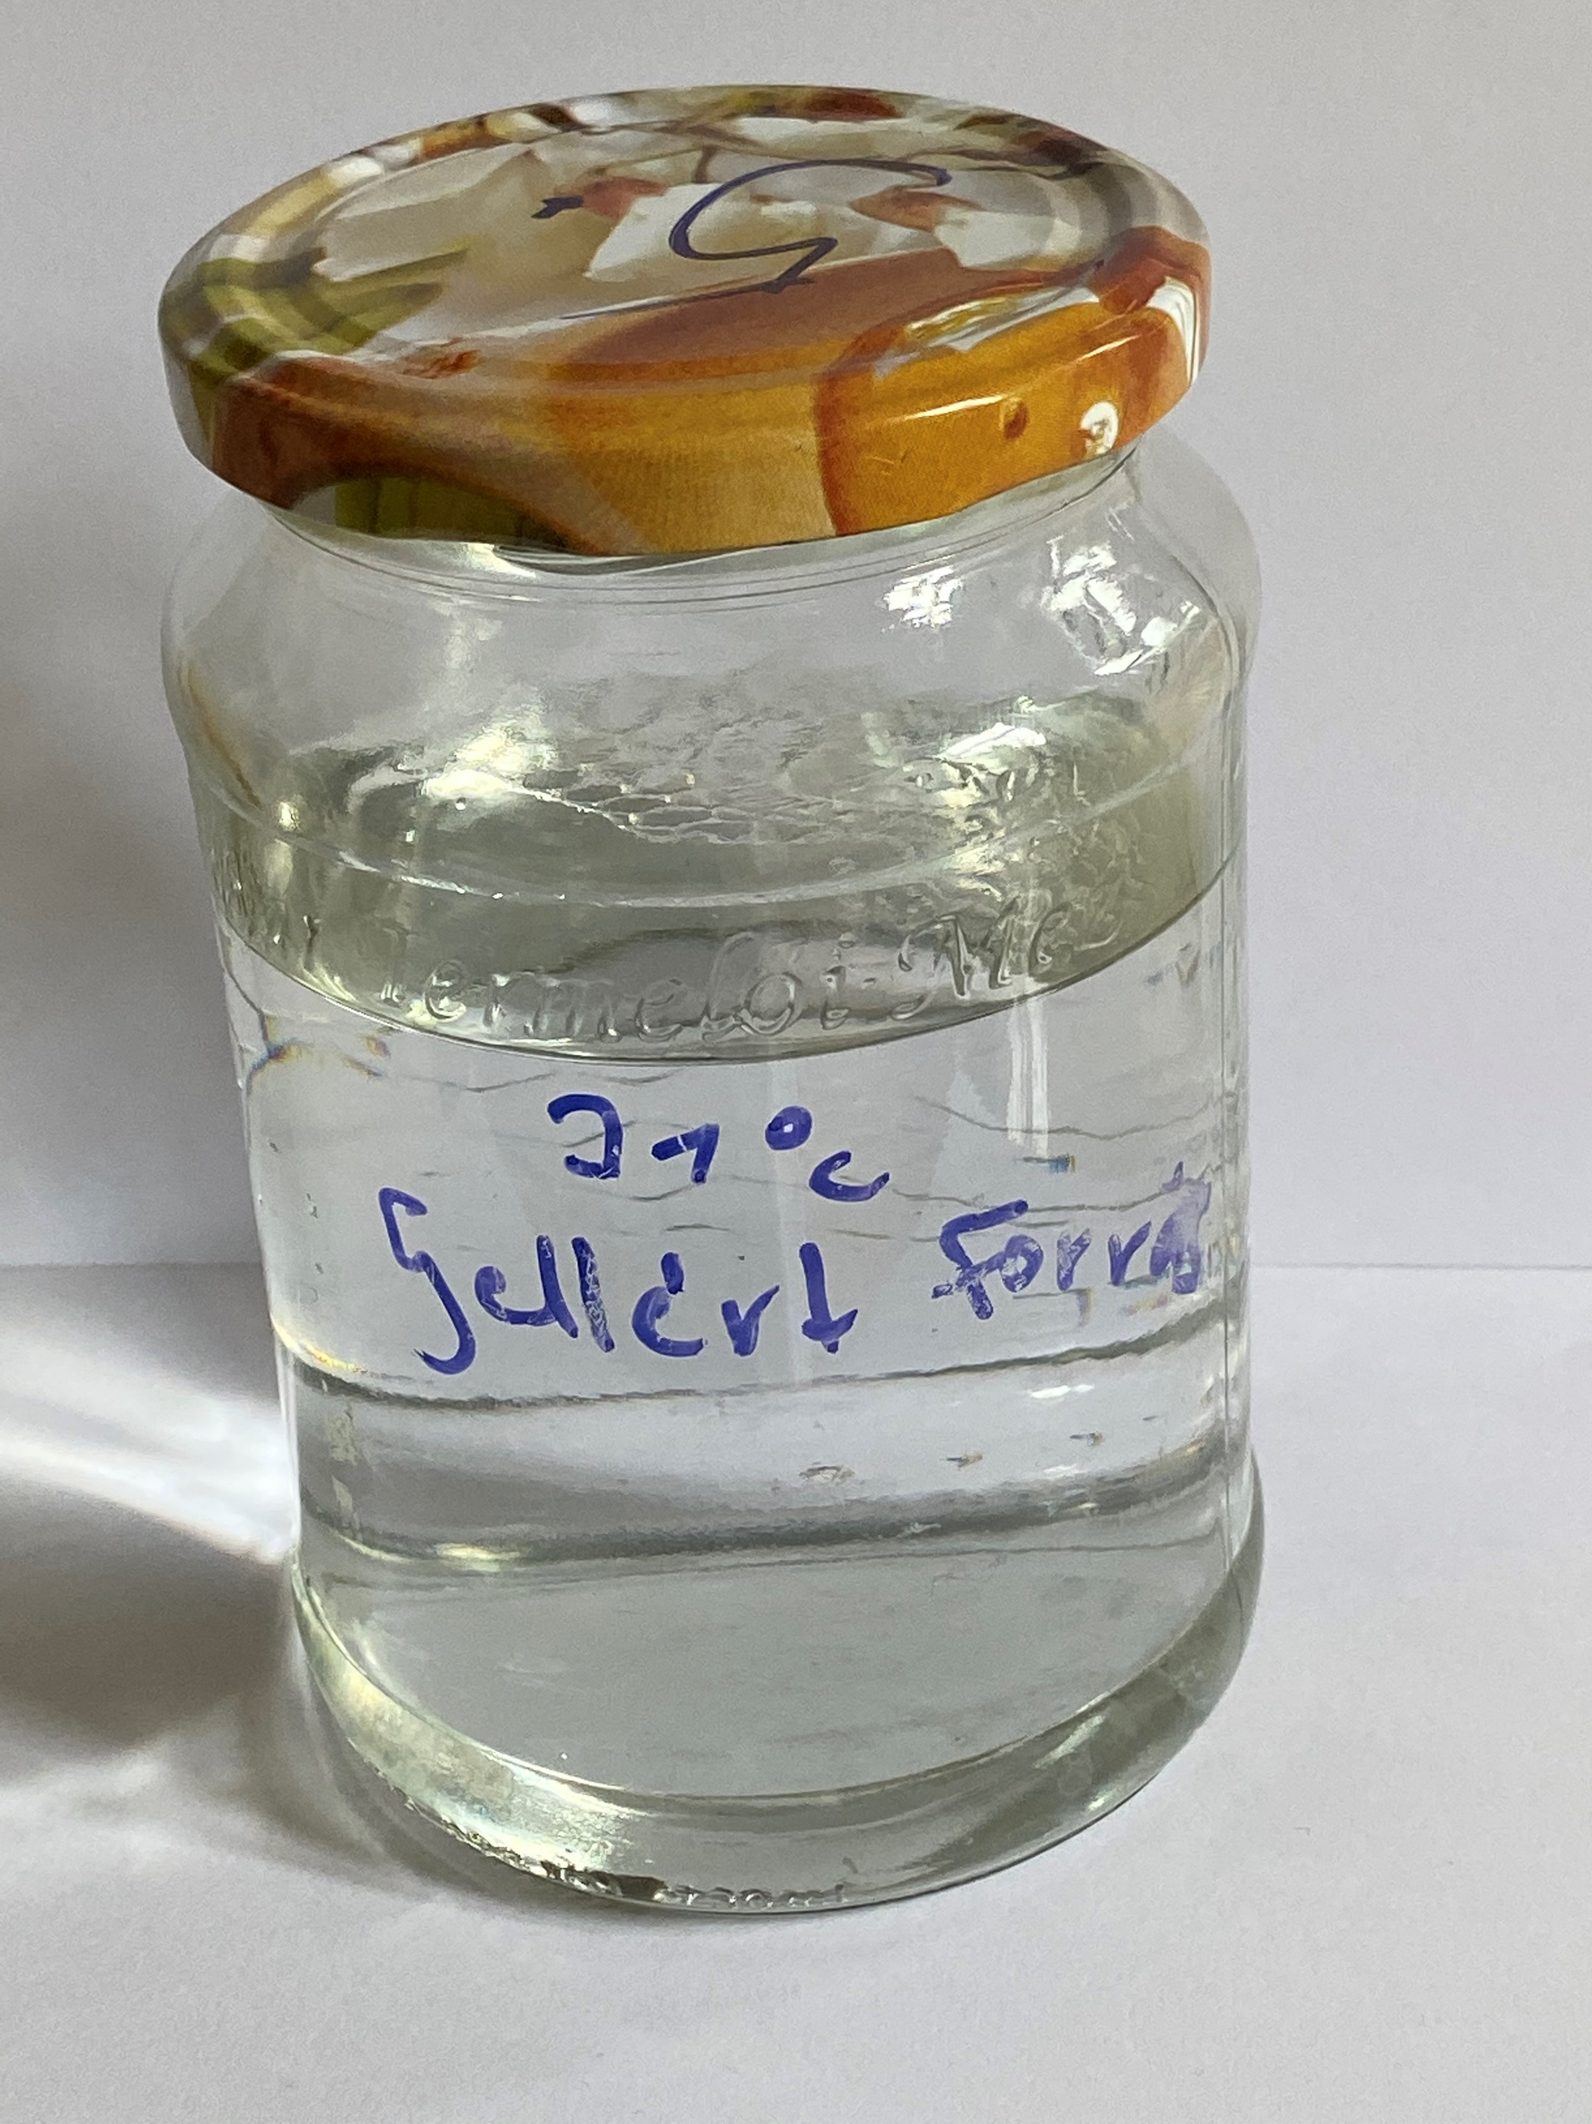
The outflow water of the Gellért Baths (Budapest)
28/09/2022
Sampling site 5.:

Slide 53
Team’s name: 5
Names of students:
Anne-Sophie
Hanne
Sara
Csenge

Slide 54
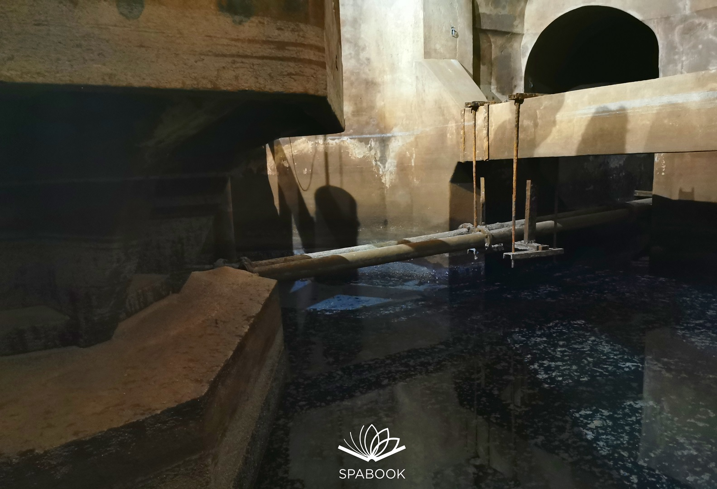
Pictures of the sampling location
https://www.google.com/url?sa=i&url=https%3A%2F%2Fspabook.net%2Fblog%2Ffurdok%2Fgellert-furdo-alagut%2F&psig=AOvVaw3-krgNyKIAlrkBvw56ZP_u&ust=1664528287034000&source=images&cd=vfe&ved=0CAwQjRxqFwoTCPiD6ZrRufoCFQAAAAAdAAAAABAN

Slide 55
1. Water temperature measurement
(at the time of sampling)
Water temperature: 21 °C

Slide 56
2. Measuring the pH value of water
Pictures of the measurement (A)
Pictures of the measurement (B)

Slide 57
A: Measurement with pH test strips | B: Measurement using reagents
7,2 | 7,5
Is the water acidic, alkaline or neutral? alkaline

Slide 58
3. Total hardness
Total water hardness: 33 drop 42,9 °e, 587,4 mg/L CaC0₃
Depending on the amount of calcium and magnesium salts, water is classified as hard or soft in different gradations:
Very soft: | 0-308 ^{O} e
Soft: | 5-8.8 ^{O} e
Medium hard: | 10-13.8 ^{O} e
Fairly hard: | 15⁰ +21.3 ^{O} e
Hard: | 22.5 - 37.5 ^{O} e
Very hard: | more than 37.5 ^{O} e

Slide 59
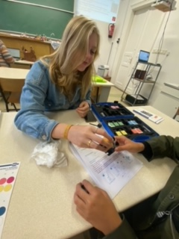
Pictures of the measurement

Slide 60
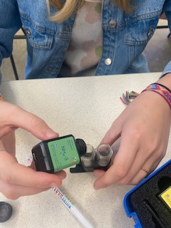
4. Ammonium
The ammonium content of water is: 0 mg/L NH₄ ⁺
Pictures of the measurement:

Slide 61
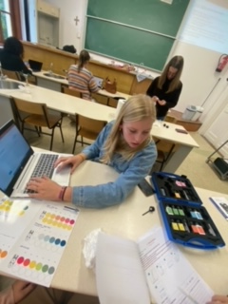
5. Nitrate
The nitrate content of water is 1 mg/L N0₃⁻
Pictures of the measurement:

Slide 62
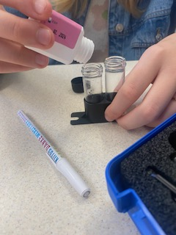
6. Nitrite
The nitrite content of water is: 1 mg/L NO₂⁻
Pictures of the measurement:

Slide 63
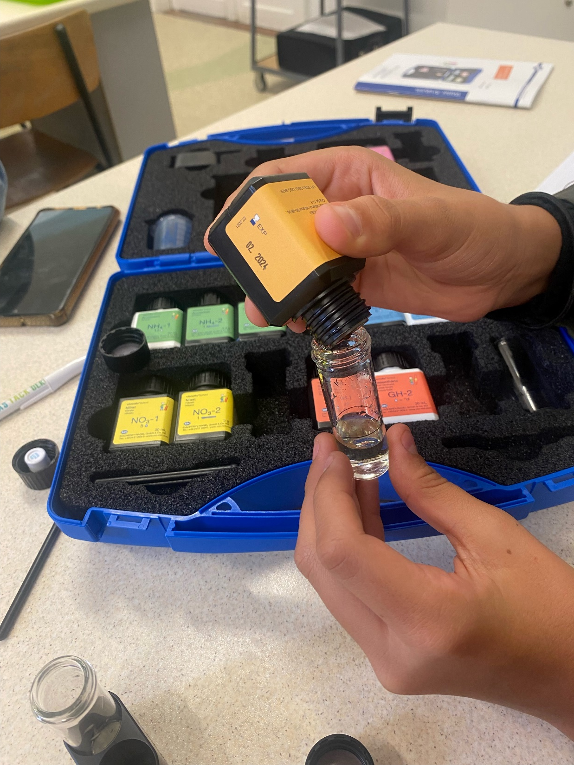
7. Phosphate
The phospate content of water is: 0 mg/L PO₄³⁻
Pictures of the measurement:

Slide 64
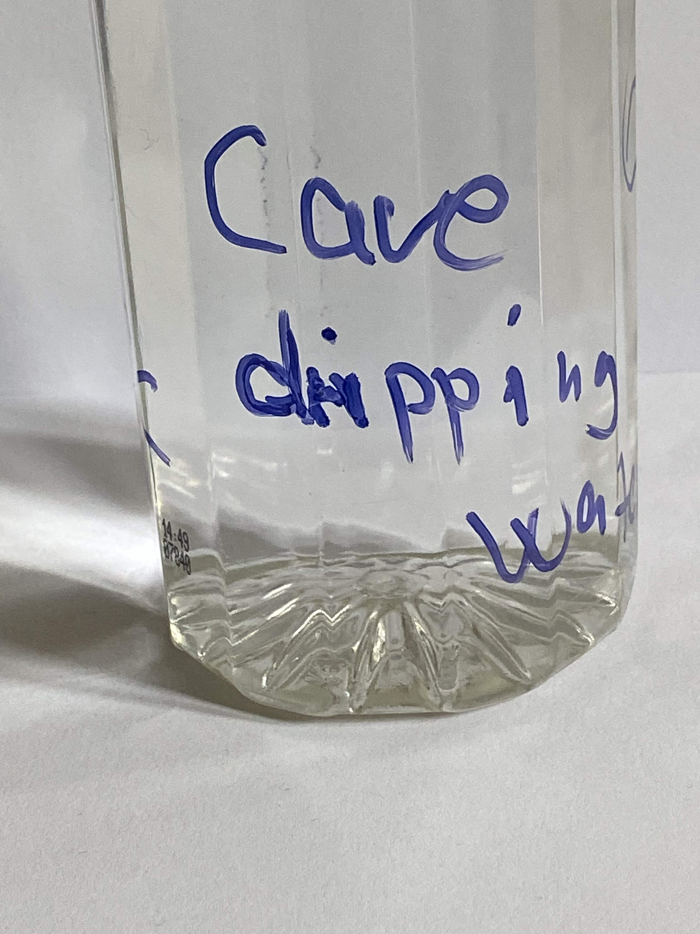
Cave (Budapest)
28/09/2022
Sampling site 6.:

Slide 65
Team’s name: Mártély
Names of students:
Velkey Zita
Zimmermann Zsolt
Sokratis Ntoulas
Juan Correa López
Lena Steenmans

Slide 66
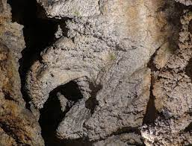
Pictures of the sampling location

Slide 67
1. Water temperature measurement
(at the time of sampling)
Water temperature: 12 °C

Slide 68
2. Measuring the pH value of water
Pictures of the measurement (A)
Pictures of the measurement (B)

Slide 69
A: Measurement with pH test strips | B: Measurement using reagents
7,5 | 7,5
Is the water acidic, alkaline or neutral? alkaline

Slide 70
3. Total hardness
Total water hardness: 24,7 °e 338,2 mg/L CaC0₃
Depending on the amount of calcium and magnesium salts, water is classified as hard or soft in different gradations:
Very soft: | 0-308 ^{O} e
Soft: | 5-8.8 ^{O} e
Medium hard: | 10-13.8 ^{O} e
Fairly hard: | 15⁰ +21.3 ^{O} e
Hard: | 22.5 - 37.5 ^{O} e
Very hard: | more than 37.5 ^{O} e

Slide 71
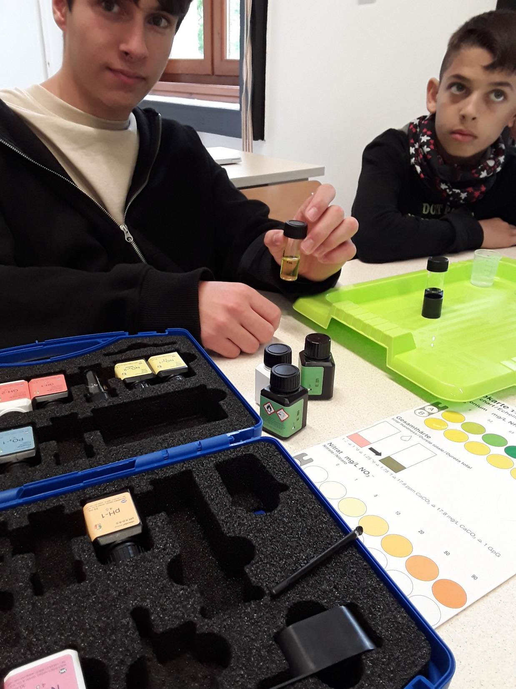
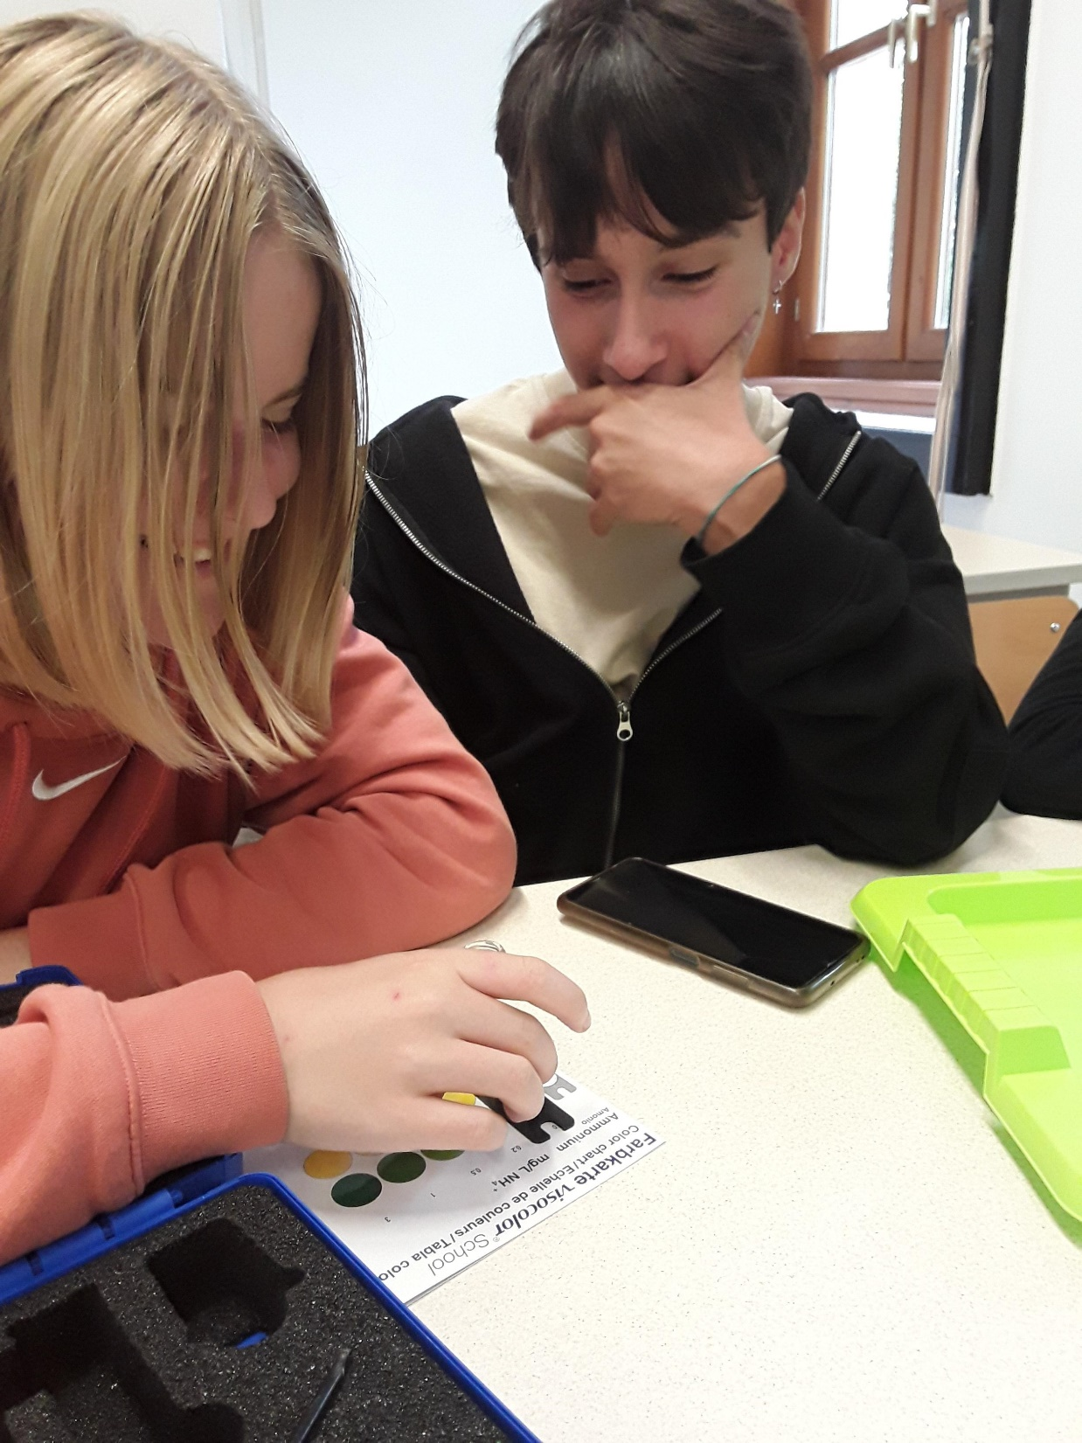
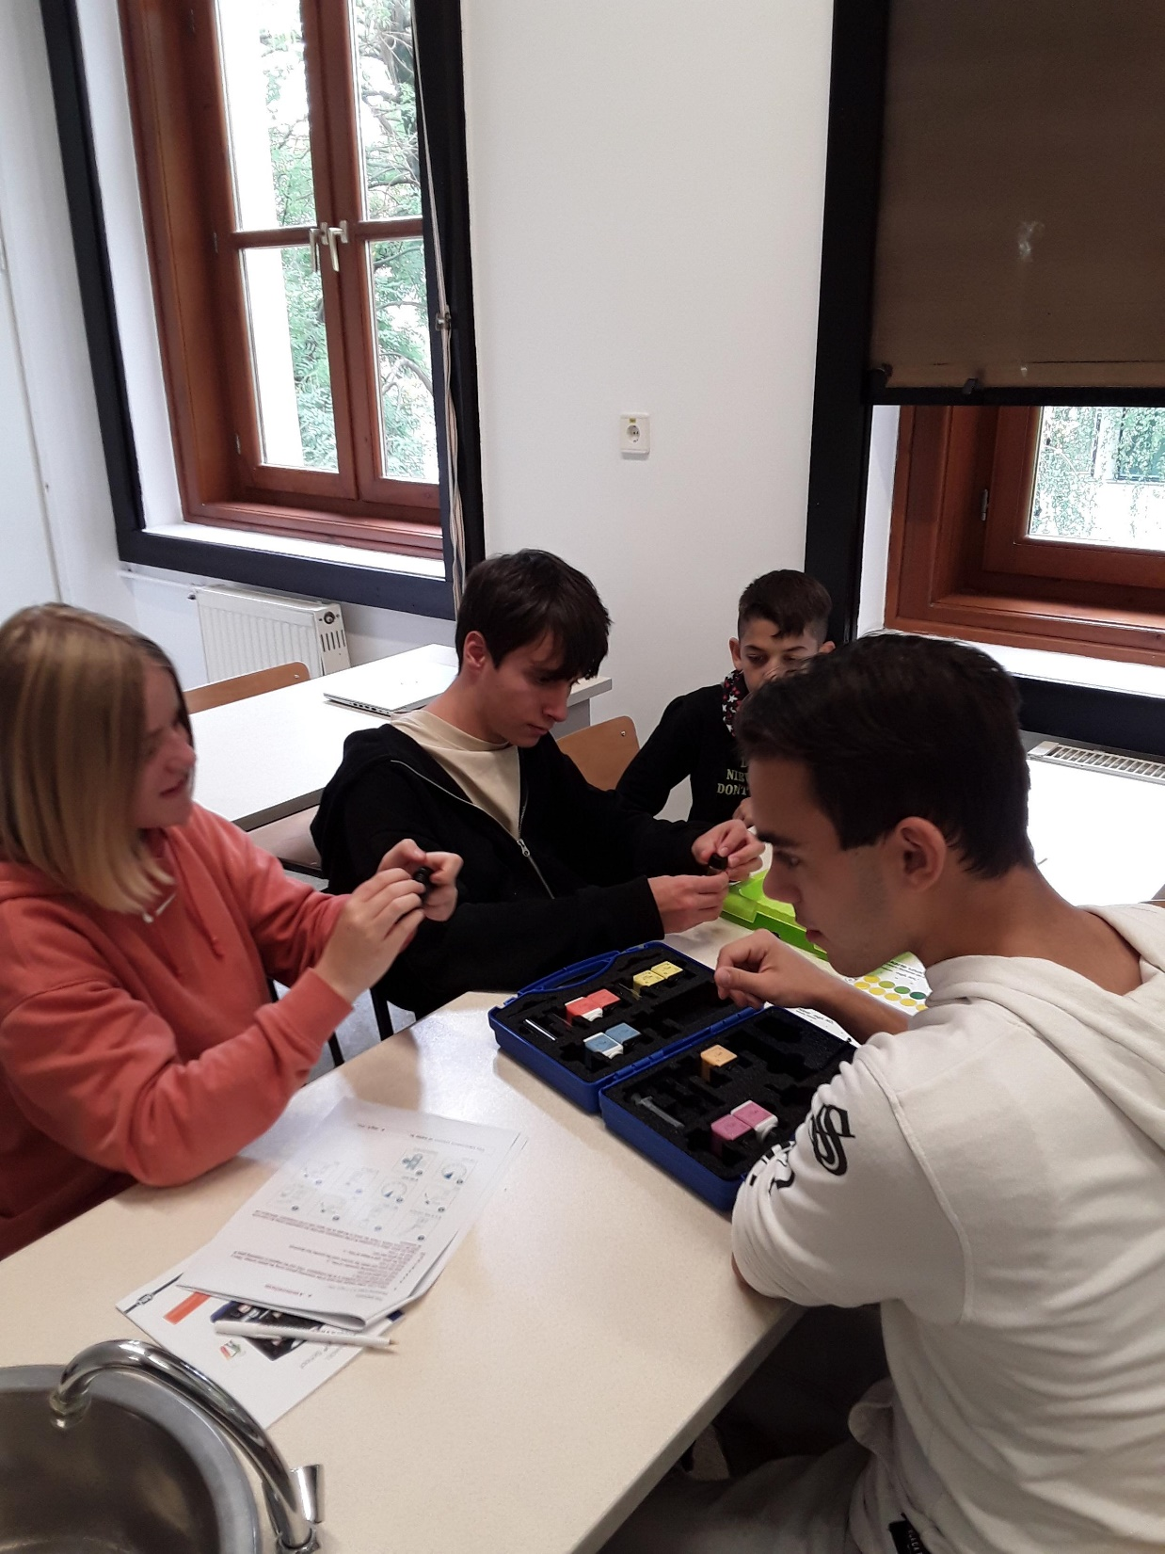
Pictures of the measurement

Slide 72
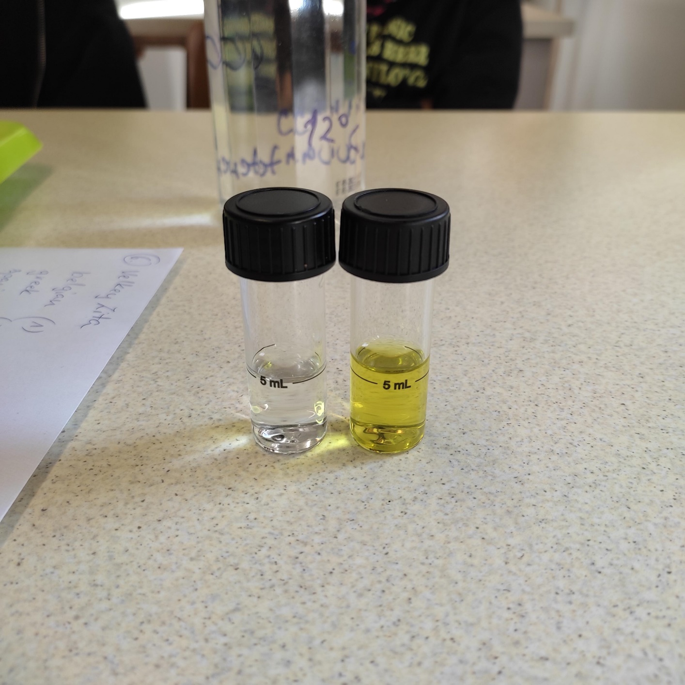
4. Ammonium
The ammonium content of water is: 0 mg/L NH₄ ⁺
Pictures of the measurement:

Slide 73
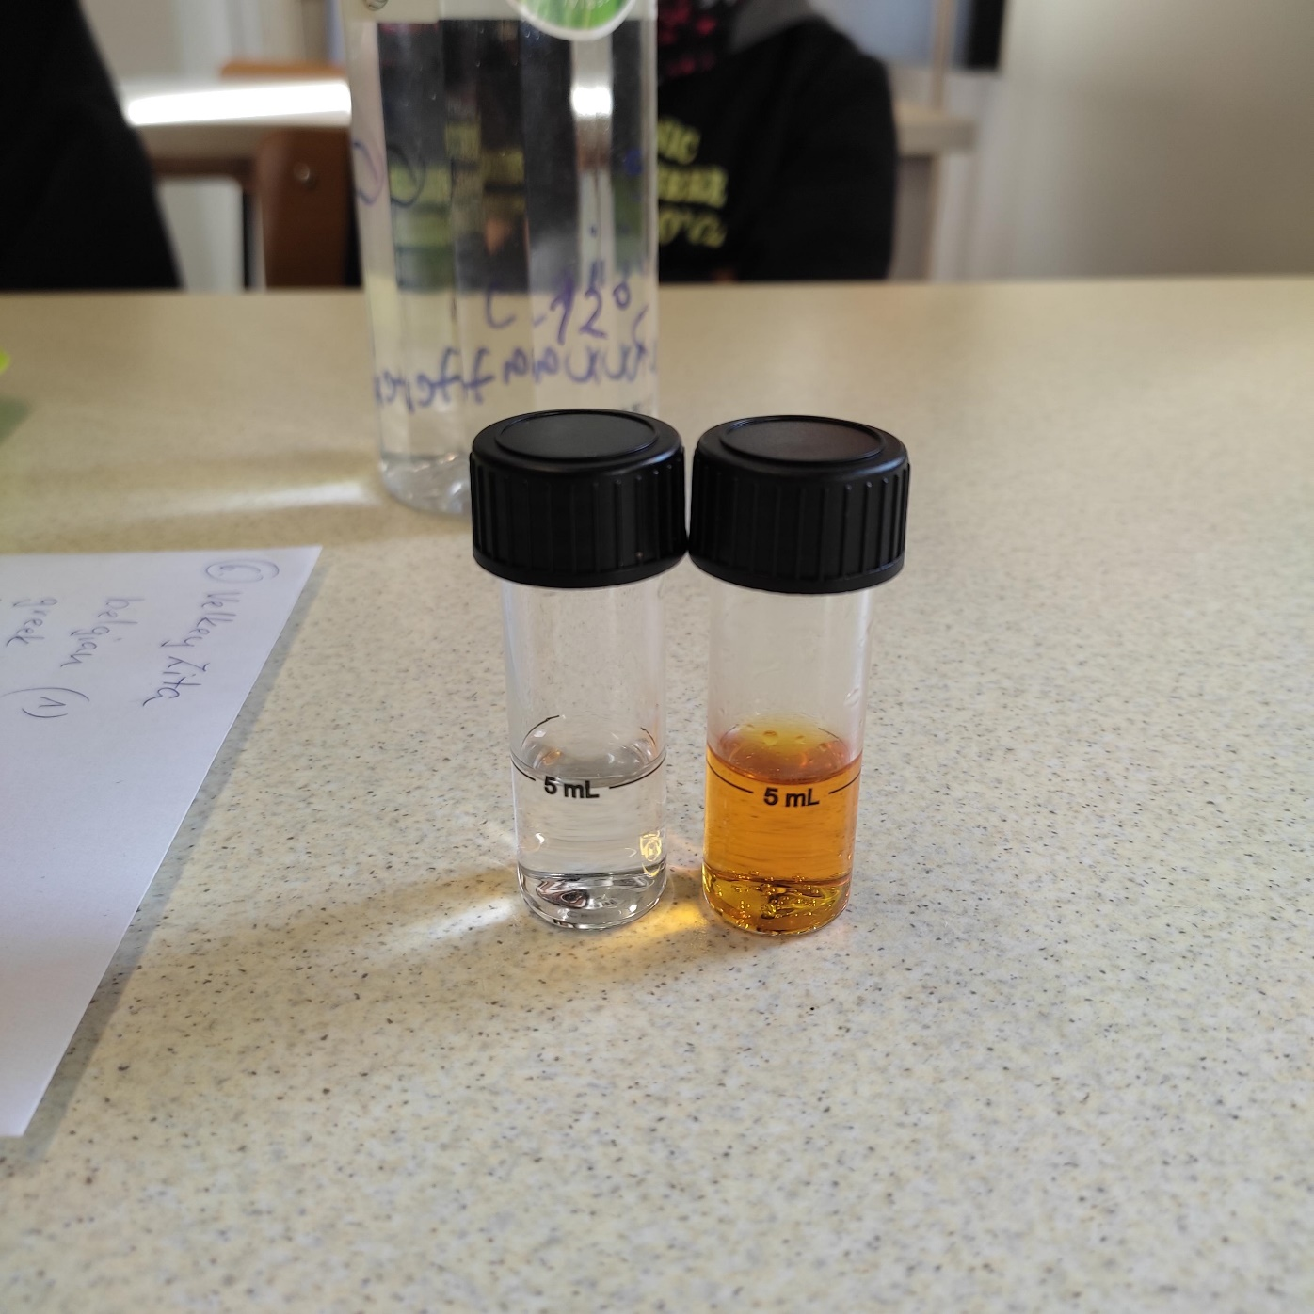
5. Nitrate
The nitrate content of water is 90 mg/L N0₃⁻
Pictures of the measurement:

Slide 74
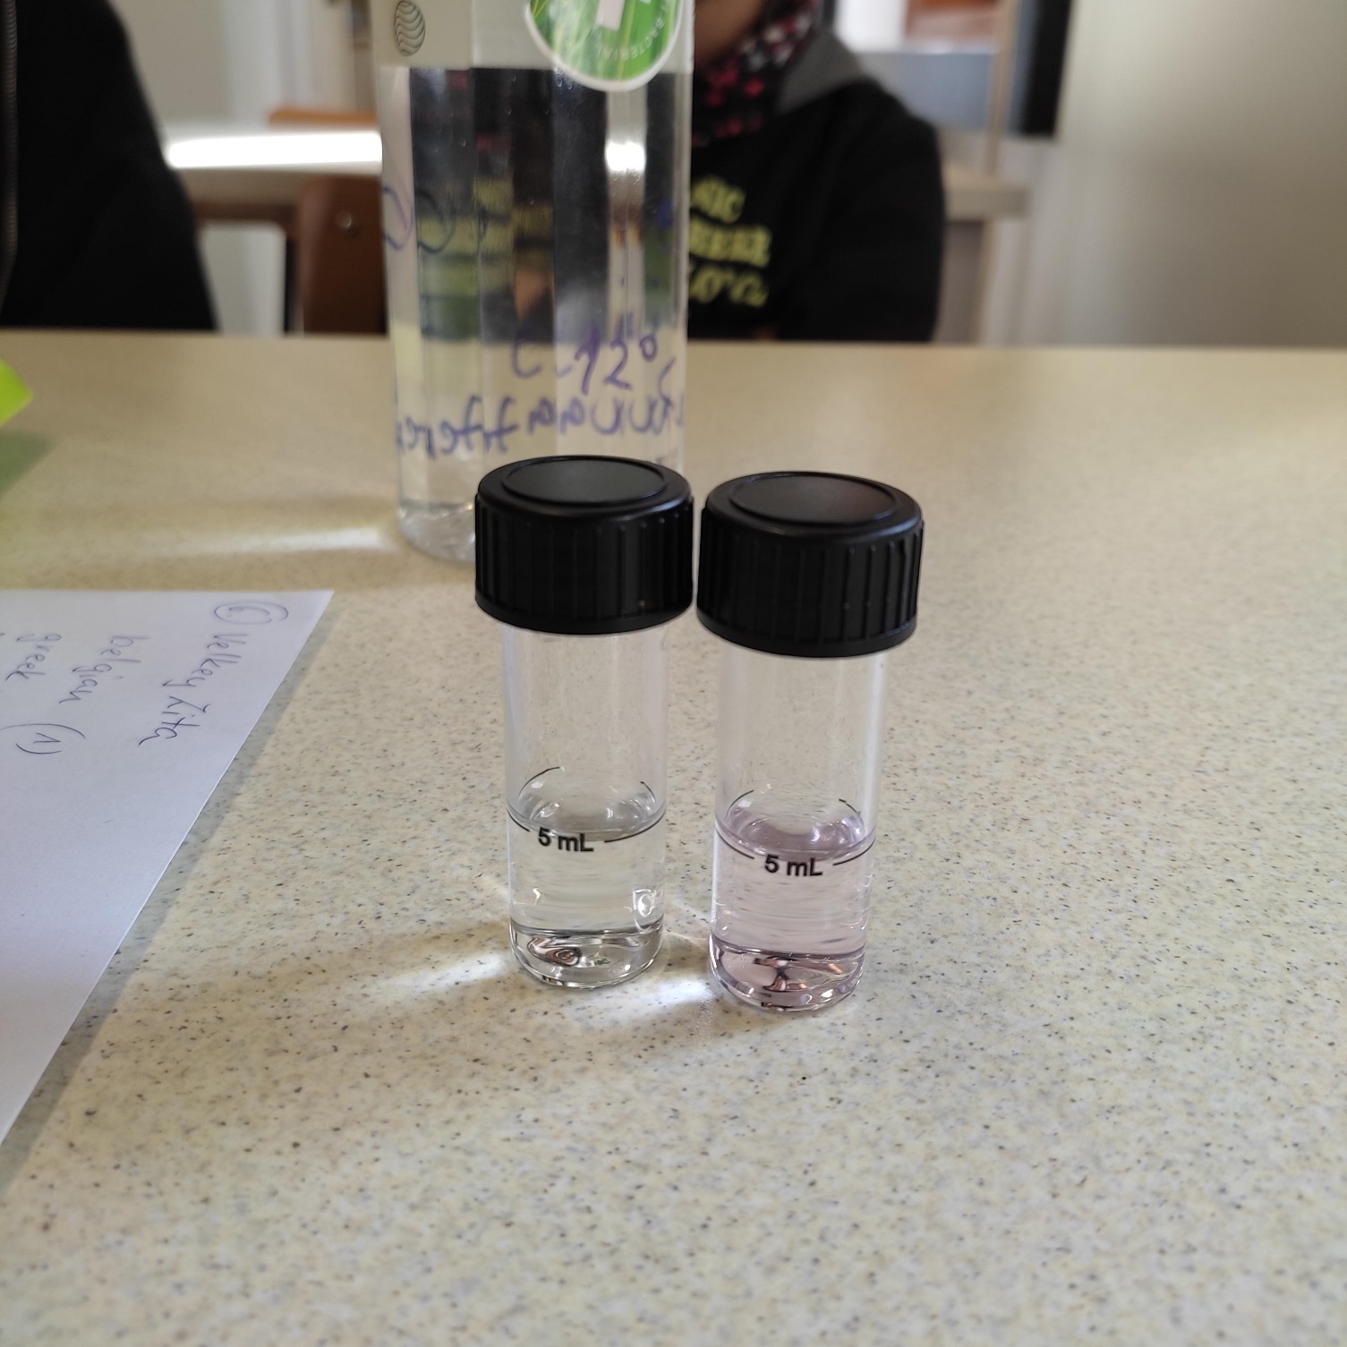
6. Nitrite
The nitrite content of water is: 0,02 mg/L NO₂⁻
Pictures of the measurement:

Slide 75
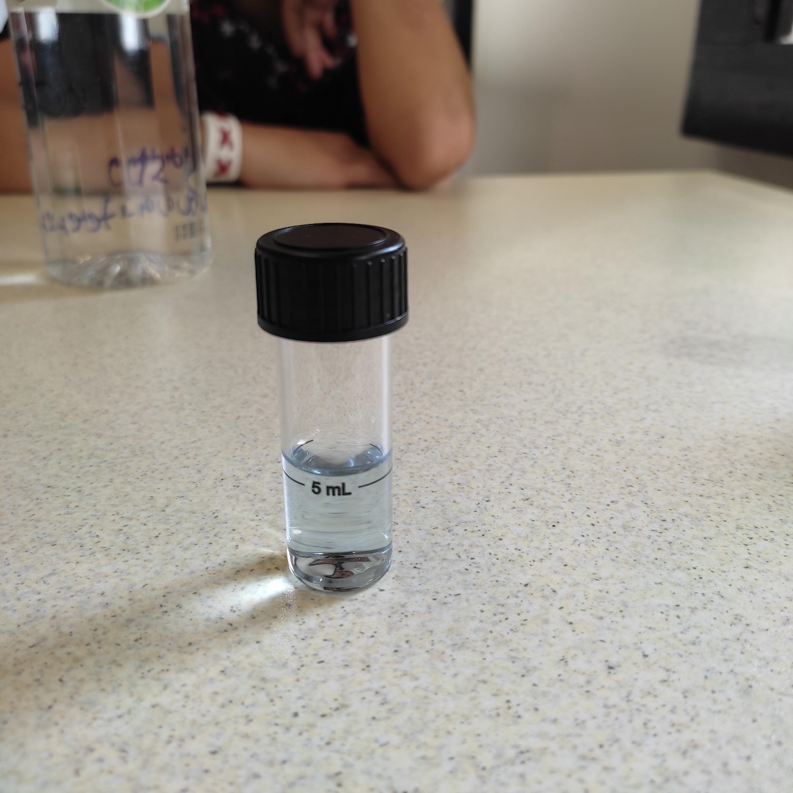
7. Phosphate
The phospate content of water is: 1,5 mg/L PO₄³⁻
Pictures of the measurement:

Slide 76
DRINKING WATER IN CHEMISTRY LABOR
29/09/2022
Sampling site 7.:

Slide 77
Team’s name: fluoroze badeendjes
Names of students: Karagity Anna, Grin Matvej, Aisha Ferreira Martinez, Alan Maceda Salgueiro, Melita Papadopoulou

Slide 78
Pictures of the sampling location

Slide 79
1. Water temperature measurement
(at the time of sampling)-20
Water temperature: 20 °C

Slide 80
2. Measuring the pH value of water
Pictures of the measurement (A)
Pictures of the measurement (B)

Slide 81
A: Measurement with pH test strips | B: Measurement using reagents
7 | 7
Is the water acidic, alkaline or neutral? ……neutral……

Slide 82
3. Total hardness
Total water hardness: 18.2 °e …249,2 mg/L CaC0₃
Depending on the amount of calcium and magnesium salts, water is classified as hard or soft in different gradations:
Very soft: | 0-308 ^{O} e
Soft: | 5-8.8 ^{O} e
Medium hard: | 10-13.8 ^{O} e
Fairly hard:- | 15⁰ +21.3 ^{O} e
Hard: | 22.5 - 37.5 ^{O} e
Very hard: | more than 37.5 ^{O} e

Slide 83
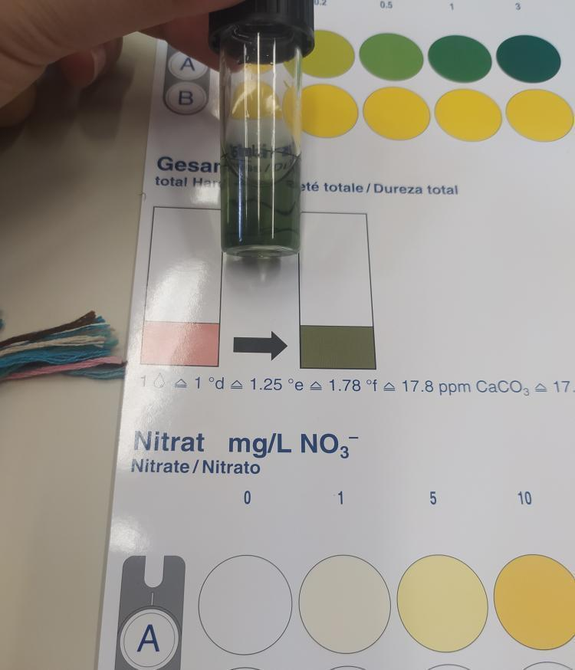
Pictures of the measurement

Slide 84
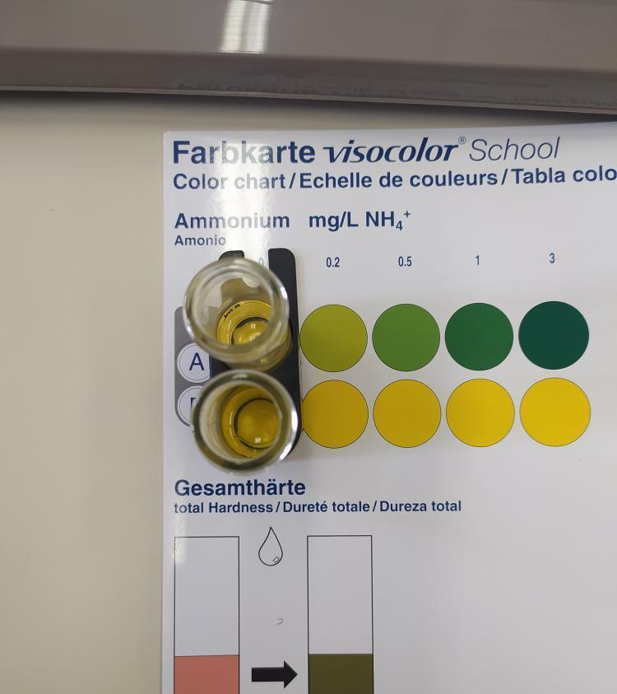
4. Ammonium
The ammonium content of water is: 0 mg/L NH₄ ⁺
Pictures of the measurement:

Slide 85
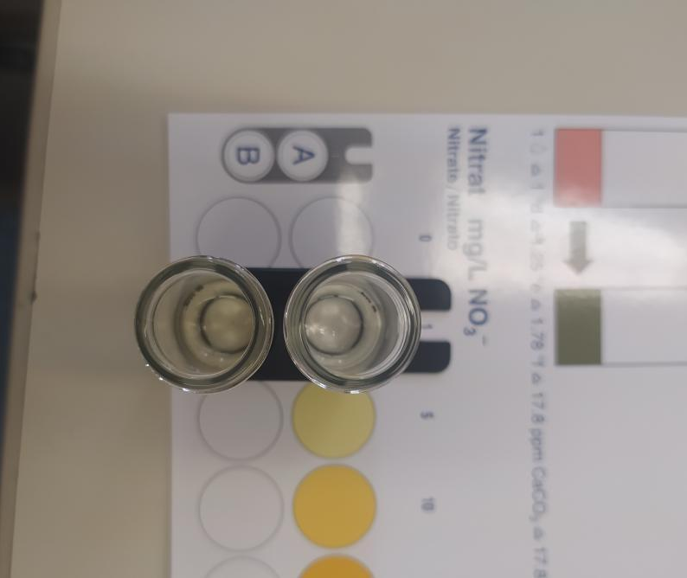
5. Nitrate
The nitrate content of water is 2.5 mg/L N0₃⁻
Pictures of the measurement:

Slide 86
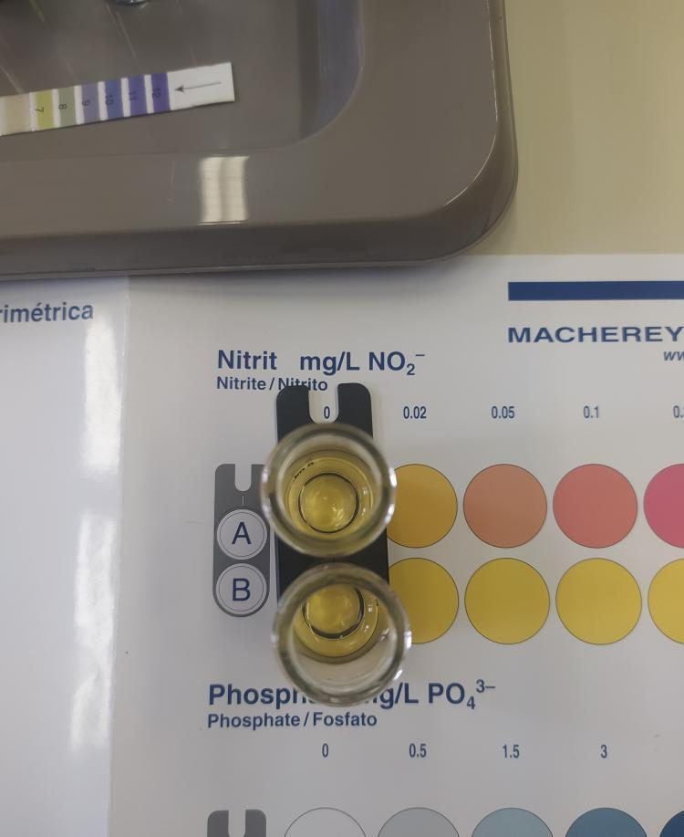
6. Nitrite
The nitrite content of water is: 0 mg/L NO₂⁻
Pictures of the measurement:

Slide 87
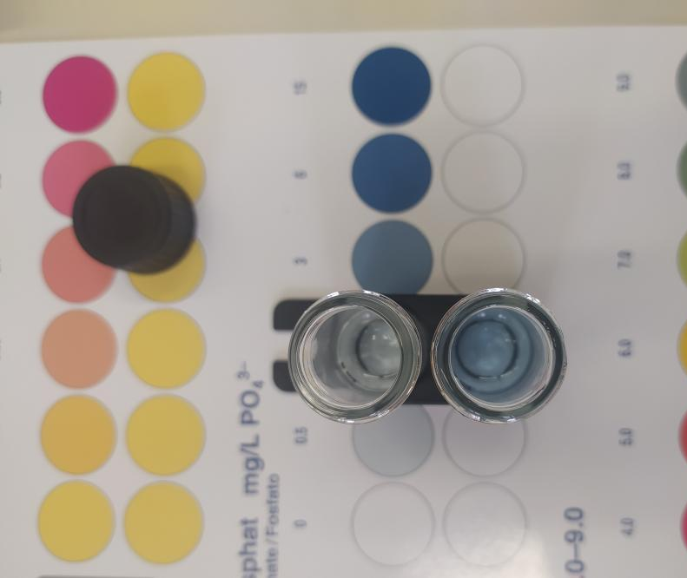
7. Phosphate
The phospate content of water is: 2 mg/L PO₄³⁻
Pictures of the measurement:

Slide 88
Szeged's drinking water
29/09/2022
Sampling site 8.:

Slide 89
Team’s name:
Names of students:
Noel Pardo Garcia
Benthe Jansen
Marie van Hissenhoven
Marina Moutsolli

Slide 90
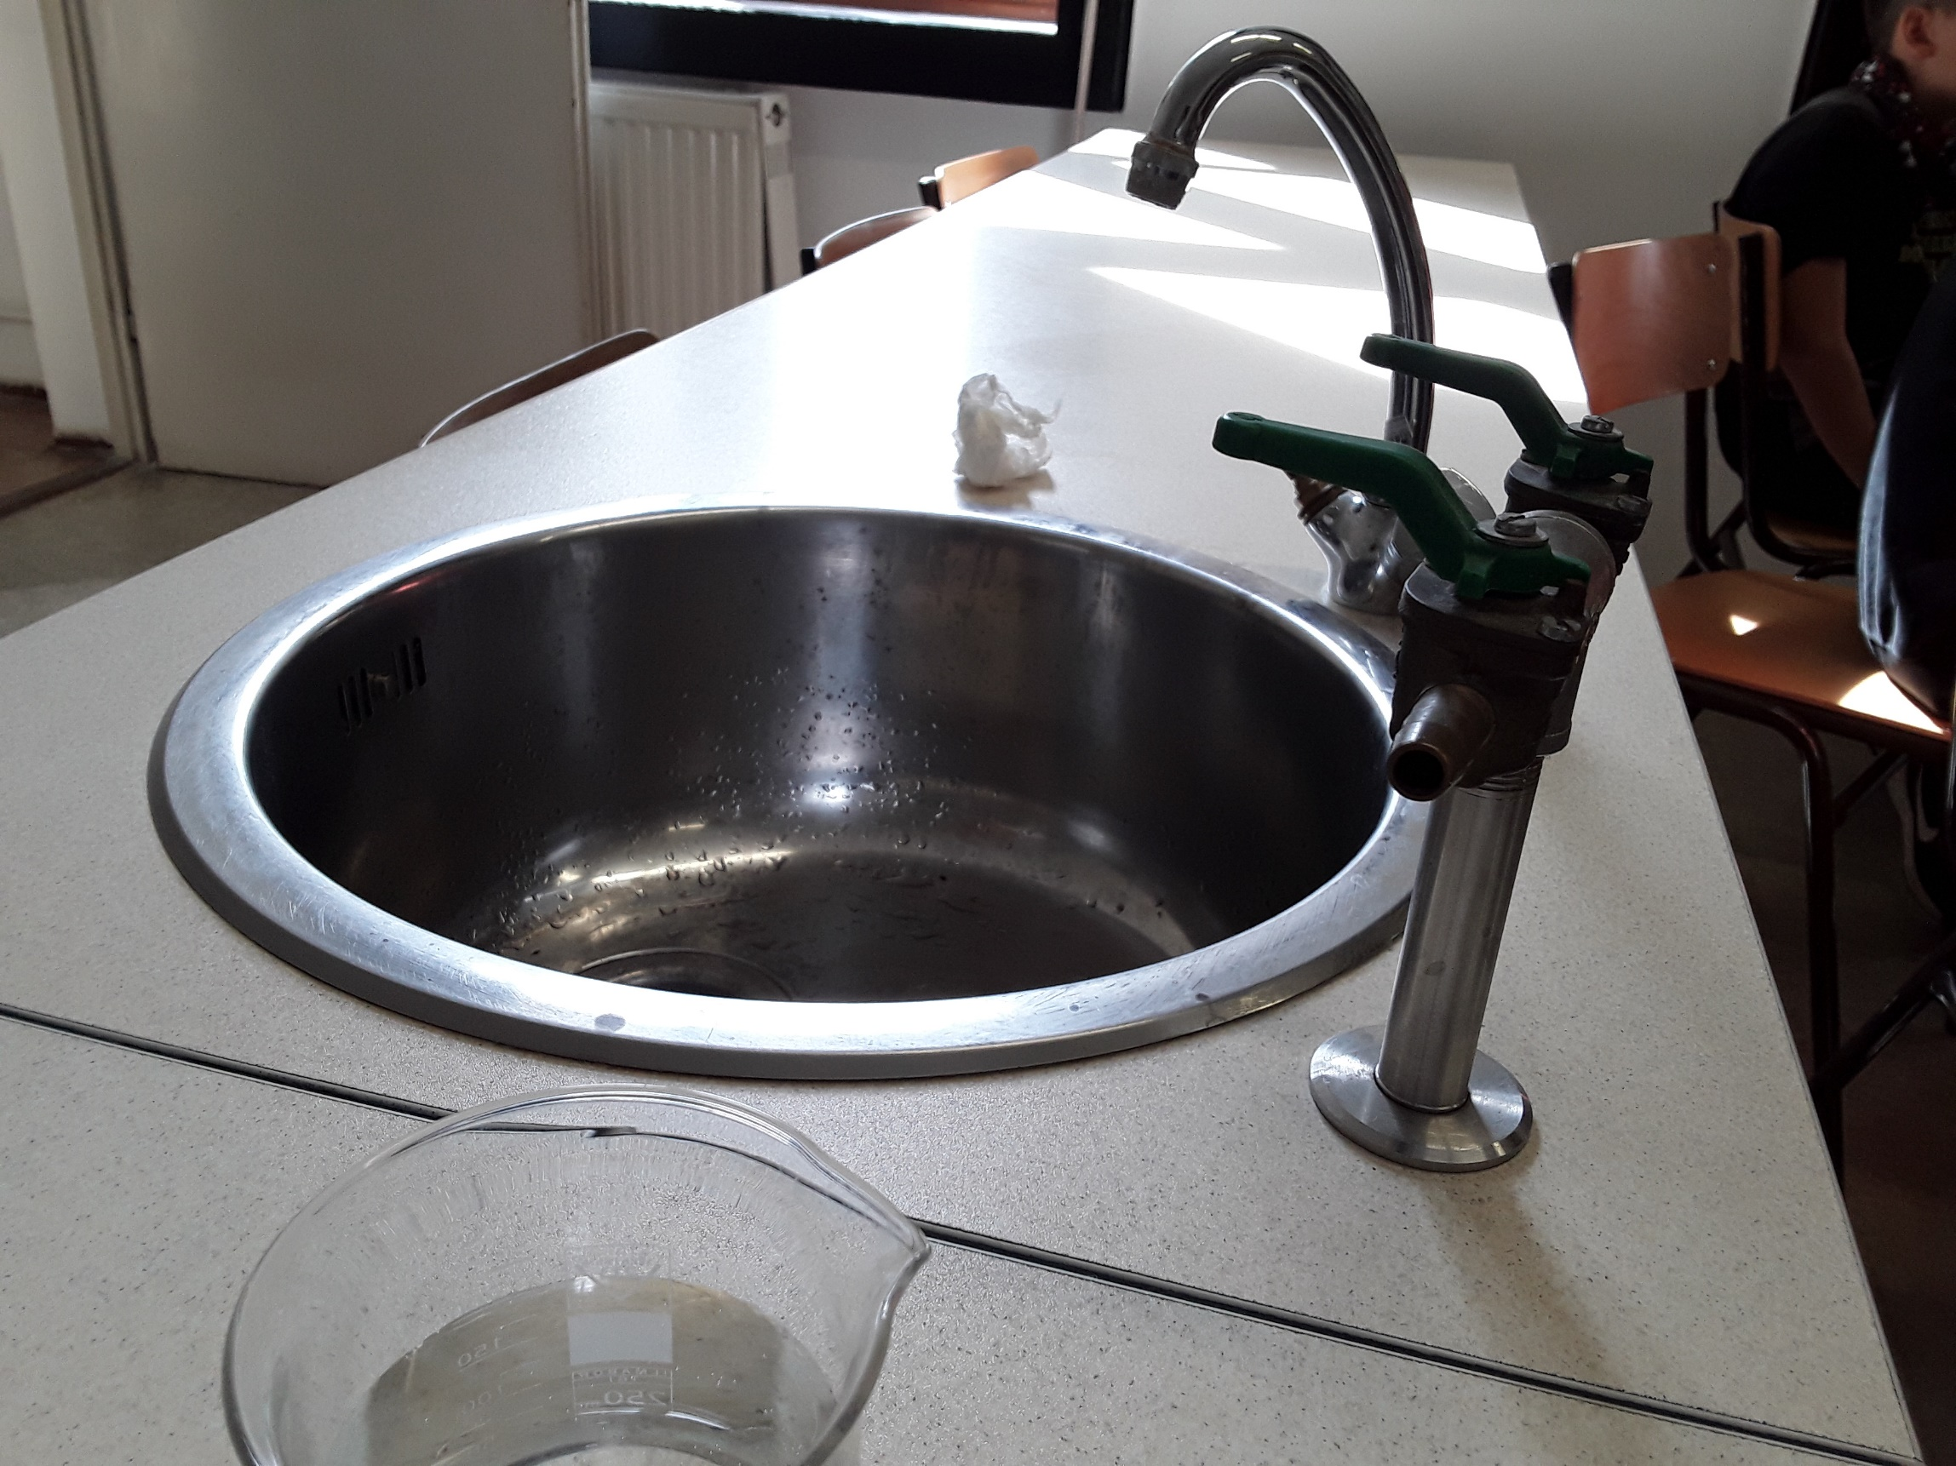
Pictures of the sampling location

Slide 91
1. Water temperature measurement
(at the time of sampling)
Water temperature: 20 °C

Slide 92
2. Measuring the pH value of water
Pictures of the measurement (A)
Pictures of the measurement (B)

Slide 93
A: Measurement with pH test strips | B: Measurement using reagents
8 | 8.0
Is the water acidic, alkaline or neutral? alkaline

Slide 94
3. Total hardness
Total water hardness: 10 drop, 13 °e 178 mg/L CaC0₃
Depending on the amount of calcium and magnesium salts, water is classified as hard or soft in different gradations:
Very soft: | 0-308 ^{O} e
Soft: | 5-8.8 ^{O} e
Medium hard: | 10-13.8 ^{O} e
Fairly hard: | 15⁰ +21.3 ^{O} e
Hard: | 22.5 - 37.5 ^{O} e
Very hard: | more than 37.5 ^{O} e

Slide 95
Pictures of the measurement

Slide 96
4. Ammonium
The ammonium content of water is: 1 mg/L NH₄ ⁺
Pictures of the measurement:

Slide 97
5. Nitrate
The nitrate content of water is 0 mg/L N0₃⁻
Pictures of the measurement:

Slide 98
6. Nitrite
The nitrite content of water is: 0 mg/L NO₂⁻
Pictures of the measurement:

Slide 99
7. Phosphate
The phospate content of water is: 3 mg/L PO₄³⁻
Pictures of the measurement:

Slide 100
Summary of measurement data

Slide 101
Sampling site | Temperatura °C | pH | total hardness | Ammonium mg/L | Nitrate mg/L | Nitrite mg/L | Phosphate mg/L
1. RIVER TISZA BETWEEN SZEGEDAND ÚJSZEGED | 16 | 7 | soft | 0 | 5 | 0,02 | 1,5
2. RIVER TISZA BETWEEN SZEGED AND THE MAROS | 16 | 7 | medium hard | 0 | 5 | 0,02 | 1,5
3. MÁRTÉLY- CUT-OFF TISZA RIVER BEND | 17 | 8 | medium hard | 0 | 0 | 0 | 0
4. RIVER DANUBE (BUDAPEST) | 14 | 7,5 | medium hard | 0 | 5 | 0.02 | 0
5. THE OUTFLOW WATER OF THE GELLÉRT BATHS (BUDAPEST) | 31 | 7,5 | very hard | 0 | 1 | 0 | 6
6. CAVE (BUDAPEST) | 12 | 7,5 | hard | 0 | 90 | 0,02 | 1,5
7. DRINKING WATER IN CHEMISTRY LABOR | 20 | 7 | fairly hard | 0 | 2,5 | 0 | 2
8. SZEGED'S DRINKING WATER | 20 | 8 | medium hard | 1 | 0 | 0 | 3

